Slide 1
Module 1
Partnership as a Foundation for Multi-Actor Interventions

Slide 2
Introduction
Module 1: Partnership as a Foundation for Multi-Actor Interventions
An effective multi-stakeholder intervention requires the creation of a team.
An effective team requires members who communicate effectively.
Relationship-building takes place through effective communication.
Effective communication leads to collaboration and increased impact by the team.
The single biggest problem in communications is the illusion that it has taken place.

Slide 3
Learning Objectives
Module 1: Partnership as a Foundation for Multi-Actor Interventions
Understand the promise of collaboration.
Identify common objectives through effective communication.
Create a safe place for the exchange of perspectives.
Notes:
This module is about promoting collaboration through communication in a safe space in which exploration, innovation, compromise and a focus on understanding each other prevail. These skills are key to being able to discuss sensitive and differing perspectives.

Slide 4
Multi-Stakeholder Process = Multitude of World Views
Module 1: Partnership as a Foundation for Multi-Actor Interventions
Culture
Happiness
Being
Professional
Wealth
Convenience
Your behaviour
(how you act)
Faith
Your beliefs
(ideas you hold to be true)
Your values
(what is important to you)
Your attitudes
(how you treat others and approach situations)
Education
Experience
Career
Success
Peer pressure
Family
Respect
Mentors
Figure 1. Adapted from “Personal beliefs, values, attitudes and behaviour”
by the Ministry of Business, Innovation and Employment of New Zealand, n.d.
Retrieved from https://www.iaa.govt.nz/for-advisers/adviser-tools/ethics-toolkit/personal-beliefs-values-attitudes-and-behaviour/.
Notes:
This slide aims at explaining the results of the paper-folding exercise. It shows that each participant has a different understanding of most issues that they will be working on together and it sets up the need to communicate clearly and effectively.

Slide 5
Communicate to Collaborate
Module 1: Partnership as a Foundation for Multi-Actor Interventions
Understand the purpose of the collaboration.
Define the goals of the work.
Define roles for the team.
Make it clear that collaboration is expected.
Identify the strengths of each member of the team.
Encourage creativity, innovation, and unique approaches.
Build a desire for cohesion.
Relationships are central.
Get to know each other.
Establish trust and promote transparency.
Notes:
Collaboration requires effective communication tools as access to information across a group is key to impact.
Groups who are able to collaborate tend to innovate better and respond to specific conditions faster and better. They tend to experience higher levels of morale and productivity. And better and more collaboration equals fewer mistakes and bad surprises which can significantly hinder any process. But how can that be achieved?
Understand the purpose of the collaboration: People on your team, or those involved in cross-team projects, need to know why they are needed. That means helping them understand why the project exists, what it means to the team, and how they can help achieve a positive outcome.
Define the goals of the work: Once people know the main objective of a project or other work initiative, it’s time to set goals. This helps align everyone right from the start and leads to more effective team collaboration.
Define roles for the team: Every person on the team contributes specific strengths. Collaborating means bringing these strengths to the forefront to make something better than someone could do alone. This works best when each contributor knows how he or she is needed. It is the job of the project or team leader to make these roles clear at the outset.
Make it clear collaboration is expected: Collaborating requires time and patience – working alone has different outcomes – but working together on P/CVE is crucial. Setting that expectation and verbalising the costs of not doing so are key to getting people to buy-in. People need to know what role is expected of them, including the commitment it will require in terms of time, resources and support by other group members.
Identify the strengths of the team: All great teams are great because each member contributes their strength and those have to be understood at the beginning of the relationship as it determines roles and responsibilities.
Encourage a creative environment: Brainstorming by questioning and thinking out loud in a non-judgmental framework.
Build a desire for cohesion: Being collaborative means involving all team members in some of the bigger, impactful decisions to keep everyone on the same page and allows them to refocus their time and energy where needed.
Relationships are key: Collaboration thrives on connection. Avoid just putting people together and telling them to get work done. Teams need time to get to know one another, to discover each other’s strengths and weaknesses, to build trust, and develop a common vision for the work to be done.
Get to know each other: Because we are all different, it is worth it to invest in an appropriate interest level in what makes everyone in the collaborative group tick. An established camaraderie helps us to learn how to best interact when things at work require teamwork.
Trust holds things together: Trust is what allows us to have the confidence that our team members will do what they say they will do, so we do not have to worry about it. Without it, collaboration cannot truly happen.
Be transparent: We all make mistakes. We all need help sometimes. True collaborators are honest when they need an extra hand or some extra time to finish a task. They also come to the quick aid when someone else needs to solve a problem.

Slide 6
Strategic Listening
Module 1: Partnership as a Foundation for Multi-Actor Interventions
…is a process that usually changes the listener as well as the interlocutor.
…is a key tool toward mutual understanding and real communication.
…builds relationships by signalling many different messages.
…opens to another point of view. It invites our ideas to shift as we take into account new information and new possibilities.
Notes:
Strategic listening builds a relationship by creating a safe space to share missions, caveats and ideas.
It fosters innovation and creativity, and is key to customisation of solutions to specific contexts.
It also establishes a dynamic between stakeholders.

Slide 7
Strategic Listening
Module 1: Partnership as a Foundation for Multi-Actor Interventions
The art of asking powerful questions.
What is the work that you want the question to do?
What is the impact that you want the question to have?
The way we ask questions impacts the dynamic of a conversation and of the relationship of the stakeholders.
Notes:
Strategic listening allows members of any group/team to engage in purposeful/mindful conversations which aim to achieve something specific.
Strategic listening is about participating actively in a conversation by asking probing questions which allow you to gain a comprehensive picture of a specific context, system, approach, etc. Strategic listening – or strategic conversations – is a key tool to understand each other and achieve a level of communication which is conducive to contributing to a collaborative process.
Strategic listening is about paying attention to:
1. Facts 2. Meaning 3. Feelings 4. Intention
It is about seeking to understand a specific process, system, practice, and to get a clear picture of what an interlocutor is telling us – by asking powerful questions.
[Discuss slide content and expand on the two questions on the slide. Ask the participants to think of examples of what questions can do and what impact they can have to get them to integrate the need and utility of asking powerful questions as a key skill set to listen strategically].

Slide 8
Asking Powerful Questions
Module 1: Partnership as a Foundation for Multi-Actor Interventions
Open-Ended Questions
Close-Ended Questions
Cannot be answered with ‘yes’ or ‘no’.
Begin with “what…”, “how…”, “can you tell me…”, “please explain…”, etc.
Invite more information.
Can only be answered with ‘yes’ or ‘no’.
Begin with “do…”, “are…”, etc.
Notes:
How to ask powerful questions?
Ask open-ended questions: Questions you can answer “yes” or “no” are closed-ended. They don’t generate discussion and they rarely yield any insight. By asking open-ended questions, you get far more interesting insights. For example, instead of asking, “Are you happy with your results?” you might ask, “Why do you think you got the results you did?” The first question can only be answered “yes” or “no.” The second question invites reflection and starts a discussion.
Get behind the assumptions: Every decision is based on assumptions. If you don’t understand these assumptions, you may make a bad decision. It’s often helpful to ask yourself first—and others in the team—, “What are we assuming in this scenario? Then keep peeling the layers off the onion until you get comfortable with the assumptions. This is where people often make mistakes. Their logic may be impeccable, but if it’s built on faulty assumptions, it will lead to a faulty conclusion.
Get both sides of the story: It is so easy to hear one side of the story, act on the information, and then be embarrassed when you find out that you only had half the facts.
Ask follow-up questions: Avoid the temptation to comment on every question. See how many questions I can ask in a row without commenting. It’s amazing what you can learn when you do this. And it makes your comments or decisions much more informed. Often you don’t get to the real meat of an issue until you have gone several questions deep.
Get comfortable with silence: Most people get uncomfortable when things get quiet. They feel the obligation to fill the space with chatter. You can let this work to your advantage by just keeping your lips locked and your ears open. When you do, you will often find that people volunteer amazing amounts of information that you would have never obtained any other way.
Help people discover their own insights: Ask rather than tell to accomplish far more by leading them with good questions.
Understand the difference between facts and speculation: Tell others what you know and what you think you know, and make sure they know the difference. Often you will have to ask, “Do you know that to be a fact?” If so, “How do you know?” or “Can you provide me with the source for that statistic or claim?”

Slide 9
Guided Practice
Module 1: Partnership as a Foundation for Multi-Actor Interventions
Practice asking questions about each other to understand interests, worldviews, understanding of respective missions and activities, as well as goals and limitations.
Identify areas of possible conflict/disagreement and miscommunication and root causes by formulating questions.
Reflect about the questions and what they will accomplish and what risks are associated with them.
Notes:
[Divide participants into their preassigned groups with the instruction on this slide for 15 (if online) or 20 minutes (if in-person) and then ask each group to recount their experience in plenary for 15 (if online) or 20 minutes (if in-person)].

Slide 11
Module 2
Levelling the Playing Field

Slide 12
Introduction
Module 2: Levelling the Playing Field
Diversity of experience.
Develop common conceptual and terminological baseline and understanding.
Notes:
There is a wide range of expertise, backgrounds of actors, with different levels of exposure to/understanding of key concepts/terms, e.g., radicalisation, violent extremism, social cohesion, P/CVE, etc. It is therefore essential to develop a common conceptual and terminological baseline and understanding to help facilitate multi-disciplinary collaboration and leverage experiences, networks, and areas of responsibility.

Slide 13
Goal
Module 2: Levelling the Playing Field
Ensure those involved in developing and implementing multi-actor P/CVE intervention programmes have:
Shared understanding of relevant terms/concepts.
Appreciation of benefits of multi-actor P/CVE intervention programmes.

Slide 14
Learning Objectives
Module 2: Levelling the Playing Field
Get on the same page in relation to terminology and definitions.
Consider the complexity of radicalisation to violence.
Understand the merits of adopting a public health approach as a team.

Slide 15
Key Foundational Terms and Concepts
Module 2: Levelling the Playing Field
Radicalisation: who might have a proposed definition?
Violent extremism (VE): who might have a proposed definition?
Notes:
[The facilitator will ask participants to propose definitions for the concepts on the slide prior to discussing them].
Radicalisation: There is no single pathway - it differs by individual. Radicalisation is caused by a mix of factors, dynamics, and influences and includes different forms, e.g., violent extremism, gang-related, or hate crimes. The EU Radicalisation Awareness Network defines radicalisation as “a phased and complex process in which an individual or a group embraces a radical ideology or belief that accepts, uses, or condones violence, including acts of terrorism, to reach a specific political or ideological purpose.” (EU RAN, 2020)
Violent Extremism: The United Nations Plan of Action to Prevent Violent Extremism leaves the definition of violent extremism to national authorities but cautions that such definitions must be consistent with States’ obligations under international law, in particular international human rights law. There is, therefore, no universally agreed definition. It usually takes different forms and is a concept more expansive than that of terrorism. One possible definition is the “beliefs and actions of people who support or use ideologically motivated violence to further social, economic, religiously-based or political objectives”. (Search for Common Ground, 2019).
Practitioners should beware of an overly broad application of the concept. According to the UN Office of the High Commissioner for Human Rights, some national laws and policies describe extremism as encompassing non-violent conduct, including conduct deemed to insult national pride or breach national dignity, or knowingly disseminating false accusations against federal or regional officials. However, if laws/policies are not limited to violent extremism, such measures risk targeting the holding of an opinion or belief rather than actual conduct (United Nations Human Rights Council, 2021).

Slide 16
Key Foundational Terms and Concepts
Module 2: Levelling the Playing Field
Terrorism: how would you define terrorism in your local context?
Notes:
[The facilitator will ask participants to propose definitions for the concepts on the slide prior to discussing them].
Terrorism: It involves the use of violence to coerce and intimidate governments and populations for some sort of political or ideological goal. Terrorism is a concept that is notoriously difficult to define. For example, political disagreements exist over non-state armed groups using violence for what some perceive as legitimate purposes (e.g., the Houthis). This poses questions like “can States perpetrate violence that constitutes terrorism?”, “can parties in armed conflicts be classified as terrorists?”, or “is terrorism constituted by acts of violence OR can non-violent acts (such as fundraising and propaganda) constitute terrorism?). Often the focus is on a) the acts and b) the purpose (achievement of a goal through the use of force and/or creation of fear) – rather than the motivation and/or the political orientation.

Slide 17
Key Foundational Terms and Concepts
Module 2: Levelling the Playing Field
Violent Extremism
VS.
Terrorism
Violent Radicalisation / Extremism
VS.
Non-violent Radicalisation / Extremism
Notes:
Terrorism and violent extremism are both generally understood to be violent in nature, politically or ideologically motivated, and aimed at the public and/or its representatives (e.g., government officials). As mentioned earlier, the concept of violent extremism is regarded as being broader than that of terrorism. It encompasses a wider category of manifestations than terrorism since it includes forms of politically, ideologically, and religiously motivated violence that falls short of constituting terrorist acts. (United Nations General Assembly, 2015).
“While the two terms undoubtedly overlap and are often used interchangeably, they could be viewed as being categorically distinct, in that ‘terrorism’ potentially refers to acts – using violence to achieve an objective – while ‘violent extremism’ suggests aims and motivation. Others have suggested that ‘violent extremism’ is a broader concept that includes, but is not restricted to, terrorism”. (European Commission’s Directorate-General for International Cooperation and Development, CIVI.POL Conseil, and the Royal United Services Institute (RUSI), 2017).
Examples of non-terrorist violent extremism include hate crimes and genocide.
It is also important to distinguish between violent and non-violent radicalisation/extremism, as it helps to avoid suggesting an implicit link between radical ideas and violence. In other words, not all who hold radical (or extremist) ideas will engage in or support violent action. In fact, the ability to hold ideas – regardless of their nature – is enshrined in international law as a fundamental human right (Article 19 of the International Covenant on Civil and Political Rights).

Slide 18
Key Foundational Terms and Concepts
Module 2: Levelling the Playing Field
“Vulnerability” or “At risk”: Susceptible to radicalisation or recruitment to violent extremism/terrorism.
It involves identifying demographic criteria associated with radicalisation and recruitment, such as age, sex, education level, involvement in criminality, and recent changes in religious or ideological orientation.
Notes:
“Vulnerability” or “at risk”: This gets at “who” should be included in a P/CVE programme and for what reason and assumes that individuals exposed to factors and characteristics associated with radicalisation and recruitment are more likely to join violent extremist groups. It involves identifying demographic criteria associated with radicalisation and recruitment, such as age, sex, education level, involvement in criminality, and recent changes in religious or ideological orientation. In this regard, it is important to focus on those demonstrating behaviours and manifestations that can lead to violent extremism or those who have already committed to it and not on individuals who are simply expressing ideological, political, or religious beliefs that are protected by human rights law.

Slide 19
Key Foundational Terms and Concepts
Module 2: Levelling the Playing Field
Typology of factors for radicalisation to violent extremism:
Structural motivators
Individual incentives
Group-based dynamics
Enabling factors
Adapted from Khalil J., and Zeuthen, M, 2016.
This model was used in an EU programme on Strengthening Resilience to Violent Extremism (STRIVE II) in Kenya.
Notes:
We can distinguish four key factors for radicalisation to violent extremism:
Structural motivators: e.g., repression, corruption, unemployment, inequality, discrimination, a history of hostility between identity groups, external state interventions in the affairs of other nations.
Individual incentives: e.g., a sense of purpose (generated through acting in accordance with perceived ideological tenets), adventure, belonging, acceptance, status, material enticements, fear of repercussions by violent extremist entities, expected rewards in the afterlife.
Group-based dynamics: e.g., peer pressure, values and norms of groups that contribute and encourage recruitment, radicalisation and support for violent extremism.
Enabling factors: e.g., the presence of ‘radical’ mentors (including religious leaders, individuals from social networks, etc.), access to ‘radical’ online communities, social networks with violent extremism, associations, access to weaponry or other relevant items, a comparative lack of state influence, an absence of familial support, and so on.

Slide 20
Key Foundational Terms and Concepts
Module 2: Levelling the Playing Field
Preventing and countering violent extremism (P/CVE): “A broad range of non-coercive and preventative activities that are united by the objective of counteracting the drivers of violent extremism specific to the locations in which these initiatives occur. P/CVE includes activities that target individuals specifically identified as ‘at risk’ of being drawn into violence to the extent that this is feasible in each location”.
(European Commission, CIV.POL, and RUSI, 2017)
Counterterrorism: “Policies, laws, and strategies developed by state actors and implemented primarily by law enforcement and intelligence agencies, and sometimes by the military, aimed at killing or capturing terrorists, thwarting terrorist plots, and dismantling terrorist organisations”.
(OSCE, 2019)
* Underlining in the above not in source script. This has been added for emphasis.
Notes:
P/CVE: different terminologies are used to refer to this concept (e.g., CVE, PVE, P/CVERLT). P/CVE is intended to be inclusive of all forms of violent extremism, including primary, secondary, and tertiary prevention. While there might be some conceptual differences, the differences in terminology used are often preferences and concerns with how the public sees programming. This is because, in general, CVE , PVE, or P/CVE are all aimed at trying to complement coercive counterterrorism, with an approach aimed at reducing recruitment and mobilisation to terrorism and preventing division, building resilience to violent extremism, and strengthening and sensitise responses.
The module and course as a whole will use the term “P/CVE”, while recognising that some communities/stakeholders might have a preference for other terminology.
Counterterrorism: [Read the definition presented on the slide].

Slide 21
Key Foundational Terms and Concepts
Module 2: Levelling the Playing Field
Rationale for P/CVE
Traditional counterterrorism and law enforcement approaches alone are unable to prevent extremist violence from taking root in communities.
More comprehensive, “whole of society” efforts to address the drivers of the violence and countering VE narratives and propaganda are needed to prevent the radicalisation and recruitment of young people.
Involving non-law enforcement actors, such as social workers, mental health professionals, peers, community leaders, civil society organisations and teachers, will not involve stakeholders who might be more effective in preventing extremist violence, but allow law enforcement and other security actors to focus their attention and resources on those individuals who have already committed to violence.
(Rosand, E., 2020)
Notes:
Traditional counterterrorism and law enforcement approaches alone are unable to prevent extremist violence from taking root in communities.
More comprehensive, “whole of society” efforts to address the drivers of the violence and countering violent extremist narratives and propaganda are needed to prevent the radicalisation and recruitment of young people.
Involving non-law enforcement actors, such as social workers, mental health professionals, peers, community leaders, civil society organisations and teachers, will allow law enforcement and other security actors to focus their attention and resources on those individuals who have already committed to violence.

Slide 22
Key Foundational Terms and Concepts
Module 2: Levelling the Playing Field
Rationale for Multi-Actor P/CVE Interventions
It incentivises the involvement of those that might otherwise be reluctant to engage on P/CVE.
It is more effective to work together than having individuals working in isolation.
It increases the likelihood that families/community members will refer individuals showing behavioural signs of extremist violence before they commit to violence.
Notes:
What is the rationale for multi-actor P/CVE interventions?
It incentivises the involvement of those that might otherwise be reluctant to engage on P/CVE. Resources, responsibilities, skills needed to address individuals of concern or “at risk” of committing to violence lie more often with social, mental health, and youth workers than the police.
It is more effective to work together than having individuals working in isolation. It enables sharing of information among different organisations, which allows for more comprehensive assessment of risks/needs/strengths.
It increases the likelihood that families/community members will refer individuals showing behavioural signs of extremist violence before they commit to violence. It also allows referred individual to tap into a disparate range of services at one time, enabling them to benefit from a more comprehensive intervention or support plan than a single-actor programme would allow.

Slide 23
Key Foundational Terms and Concepts
Module 2: Levelling the Playing Field
Disengagement vs. deradicalisation (behaviour vs. beliefs): Should multi-actor P/CVE intervention programmes focus on one or the other or both?
Reintegration: “A safe transition back into a community, by which an individual proceeds to live a law-abiding life, often following release from prison, and acquires attitudes and behaviours that generally lead to a productive functioning in society”.
(Veldhuis, T., 2012)
Notes:
Disengagement: Unlike deradicalisation, disengagement is focussed on reducing the individual’s commitment to violence to where he/she no longer poses a violent threat.
Deradicalisation: Deradicalisation, however, aims at changing the individual’s belief system so that he/she rejects violent extremist ideology, while protecting his/her freedom of belief. It is used in different ways: e.g., to refer to the process of cognitive distancing, in the sense of abstaining from extremist ideology. In other cases, it may refer to both the process of cognitive distancing (leaving the extremist group) and the activities (disengagement). The combination of these two processes is referred to as exit, a somewhat vague term. Finally, deradicalisation sometimes refers to preventive activities for groups vulnerable to or in the first stages of radicalisation.
Defining the goal of the intervention/programme – whether to bring about a change in the mindset or in the behaviour of the targeted individual – is important, not least for evaluation purposes.
Reintegration: [Read the definition presented on the slide].

Slide 24
Key Foundational Terms and Concepts
Module 2: Levelling the Playing Field
Public Health Approach
Understand violent extremism as a social phenomenon and the impact it can have in society.
Emphasise prevention.
Recognise role that public health/social workers can play in reducing violence in community.
Allows for multi-purpose programming and avoiding stigma that a law enforcement-only approach does not allow.
Public Health Prevention Pyramid
Primary
Secondary
Tertiary
(Weine, S., and Eisenman, D., 2016)

Slide 25
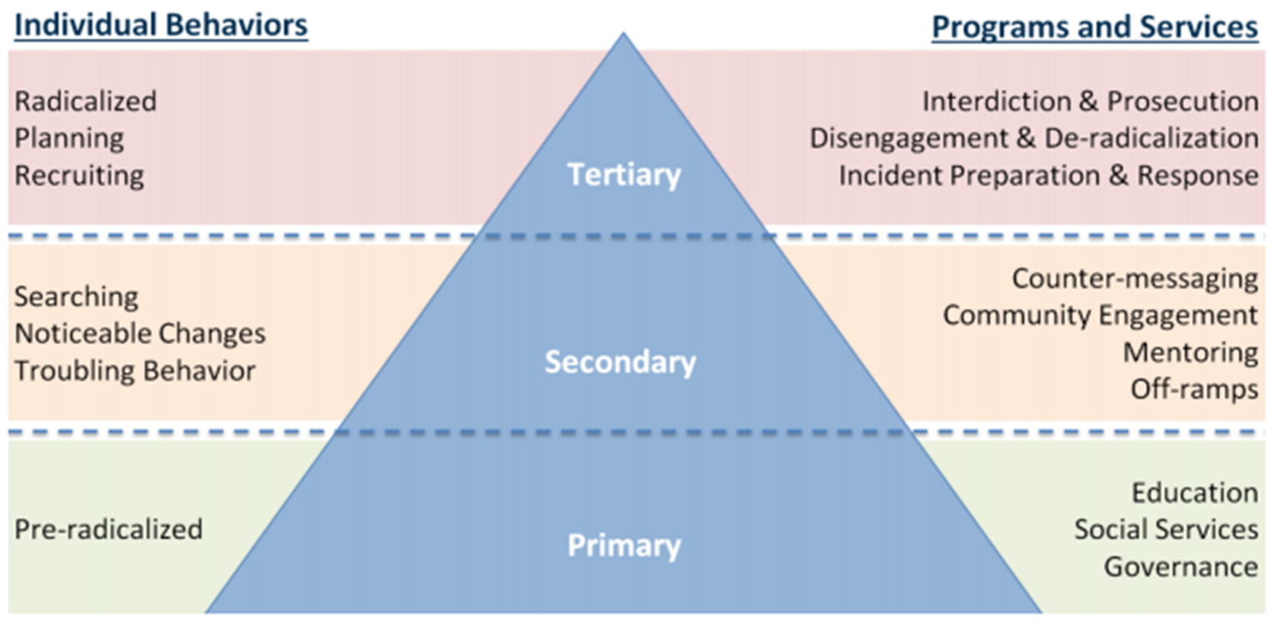
Key Foundational Terms and Concepts
Module 2: Levelling the Playing Field
Figure 1. Public Health Model of CT and P/CVE.
Reprinted from Challgren, J. et al. (2016). Countering Violent Extremism: Applying the Public Health Model. Washington, DC: Center for Security Studies. Georgetown University.

Slide 26
Key Foundational Terms and Concepts
Module 2: Levelling the Playing Field
“Do No Harm”: “through and understanding of the local context, relationships, and dynamics more broadly, this involves mitigating or avoiding negative, unintended consequences that may result from P/CVE interventions, and seeking to positively influence these dynamics”.
(United Nations General Assembly, 2015)
Notes:
“Do No Harm”: More broadly, this concept, which has traditionally been applied to development projects in conflict-affected or fragile states, refers to the ability of an organisation to understand the context in which it is operating, and the interactions between its interventions and the context; it requires an ability to act upon this understanding to avoid negative impacts.
Even in contexts that are not fragile or conflict-affected, ensuring a conflict-sensitive/”Do No Harm” approach is important due to the highly politicised nature of P/CVE programming. This approach includes analysing sources of tension, group linkages as well as programme objectives, consequences and options. These are particularly relevant for mapping the drivers of violent extremism and the complex paths to radicalisation leading to violence.
With insufficient attention to the manner in which P/CVE programmes are designed and implemented, programmes can “inadvertently have negative impacts upon the conflict or a given country or region”. An approach that seeks to “Do No Harm” allows a P/CVE programme to “continue its intervention, confident that it is minimising adverse effects on the context – or that such adverse effects will be well-mitigated if and when they arise” (UNDP, 2019).

Slide 27
Breakout Exercise
Module 2: Levelling the Playing Field
Instructions
Choose a note taker and a rapporteur for your group.
Discuss and then answer the following questions:
Agree on one locality where violent extremism (VE) is a concern.
Name at least three issues than can be conducive to vulnerability to VE in that locality.
Who is influencing or has the capacity/capability to influence (whether positively or negatively) vulnerable individuals?
To what extent are primary, secondary, and tertiary interventions (i.e., public health approach) being operationalised in your country or community?
Should P/CVE interventions in this locality focus on disengagement and/or deradicalisation and why?

Slide 28
Summary and Conclusions
Module 2: Levelling the Playing Field
Different professional backgrounds/experiences, but shared terminology and understanding of foundational concepts.
Radicalisation to violent extremism is a complex phenomenon: no single path, profile, or factor.
No single actor, agency, or organisation can address multiple factors/needs of an individual on own.
Benefits of multi-actor interventions that involve range of professionals.
Most suitable for secondary and/or tertiary prevention, but depends on the context.

Slide 30
Module 3
Common Features of a Multi-Actor P/CVE Intervention Programme

Slide 31
Introduction
Module 3: Common Features of a Multi-Actor P/CVE Intervention Programme
Contextualised and tailored approach.
A number of common elements and features.

Slide 32
Goal
Module 3: Common Features of a Multi-Actor P/CVE Intervention Programme
To identify common features of existing multi-actor P/CVE intervention programmes and different programme models and which ones are most relevant/applicable to the local context.

Slide 33
Learning Objectives
Module 3: Common Features of a Multi-Actor P/CVE Intervention Programme
Understand the common features of multi-actor P/CVE approaches that will bind the various actors together.
Identify the context specificities to be addressed to create a multi-actor intervention team.
Understand and compare different models and the actors involved in each.

Slide 34
Common Features
Module 3: Common Features of a Multi-Actor P/CVE Intervention Programme
Voluntary – based on consent.
Multiple municipal/government agencies, CBOs, CSOs; different disciplines; includes, where appropriate, police.
Referrals accepted from multiple sources.
Notes:
Common features of multi-actor P/CVE programmes include:
Voluntary/consensus-based: These programmes tend to work best when participation is voluntary and there is neither a “legal duty” to make a referral to nor requirement that an individual participate in let alone accept services offered through the programme. In some cases involving minors, however, the state and/or certain professions such as teachers/social workers might have a legal obligation to safeguard or otherwise protect an individual.
Why is this important when talking about programmes focused on non-criminal space?
Only a small number of individuals are likely to present the kind of vulnerabilities that justify a referral reporting.
Imposing a legal duty on government institutions to report individuals “at risk” of violent extremism could lead to an overreporting of false positives driven by concern about failing to report someone who then commits a crime. False positives can have a negative impact on the lives and families of individuals reported, and an abundance of false positives can undermine the credibility of a programme. In other words, mandatory reporting could result in overreporting that risks alienating certain segments of the community whose cooperation and trust is critical to the effectiveness of the mechanism.
Imposing on public officials a specific legal duty to report suspicious behaviour risks creating environments that inhibit freedom of speech (e.g., in the classroom) or erode the willingness of an individual to share information with a mental health professional or other trusted authority figure such as a teacher.
Requiring people to accept interventions when no crime has been committed risks undermining the effectiveness of the programme – unwilling participants are more likely to be unresponsive to the treatment and coercing them into accepting intervention may only harden their views.
Referrals accepted from multiple sources: Programmes typically are designed to receive referrals from different sources – whether police officer or health, social, or youth worker, family member, teacher or peer, member of social network; and offer more than one avenue for making referrals (e.g., online, telephone hotline operated by a municipality, government agency, or NGO, or in-person). This highlights the importance of awareness-raising efforts within community both to inform its members of the benefits offered by the programme and reassure them that a referral will result in positive rather than punitive outcomes.

Slide 35
Common Features
Module 3: Common Features of a Multi-Actor P/CVE Intervention Programme
Rely on contextualised individualised assessments.
Privacy-protecting information-sharing.
Notes:
Rely on contextualised individualised assessments: We just mentioned that programmes typically rely on information from multiple sources and from actors across different disciplines to assess the vulnerabilities and needs of those referred to the programme. This might include, for example, interviews with the referred individual, family members, peers, and teachers; social network observations; and the case files of social, health, or youth workers). This recognises that: a) multiple actors may have relevant information on a referred individual and that b) multidimensional and objective evaluation of an individual and the effectiveness of the programme depends in large part on the diversity of information about an individual it can gather.
Privacy-protecting information sharing: Programmes typically include a transparent protocol or agreement to enable the sharing of information and broader co-operation among those agencies, organisations, professionals, and practitioners involved in the mechanism, while protecting individual and data privacy. This can enable multiple actors to assess the individual case together effectively/safely. The framework can define the limited circumstances when information on a referred individual can be passed to the police (e.g., when risk of imminent harm).

Slide 36
Common Features
Module 3: Common Features of a Multi-Actor P/CVE Intervention Programme
Tailored intervention/support plans.
Basic levels of trust.
Notes:
Tailored intervention/support plans: They typically offer an intervention or wider support plan that is individually tailored to the identified vulnerabilities and takes into account the age, gender, cultural background, and vulnerabilities/needs presented by the individual. The range of interventions available generally depends on the professionals, practitioners, and institutions involved with the programme (which is connected to capacities/resources in the community). This may include:
Family or psychosocial counselling; drugs and alcohol awareness and treatment;
Ideological/ theological or other mentoring programmes;
Vocational training and assistance with job placement;
Conflict mediation and management training;
Tolerance and diversity training or other educational programmes;
Drug or other addiction treatment; and
Arts, music, or sports therapy.
Basic levels of trust: Programmes typically are built on a foundation of trust that exists among the practitioners and professionals from different fields involved in the programme and between community members and those leading the programme. Trust deficits, including between the police and non–law enforcement professionals and between the police and community members can undermine the ability to develop let alone operationalise and sustain a programme that involves law enforcement.

Slide 37
Breakout Exercise
Module 3: Common Features of a Multi-Actor P/CVE Intervention Programme
Instructions
Consider the extent to which the local context can incorporate these features in multi-actor P/CVE intervention programmes and barriers/challenges to such incorporation.
Multiple municipal/govt agencies, CSOs; different disciplines; includes, where appropriate, police
Referrals accepted from multiple sources
Rely on contextualised individualised assessments
Tailored intervention/ support plans
Privacy-protecting information-sharing
Voluntary
Basic levels of trust
Notes:
[Split participants into their preassigned groups and distribute the seven features evenly among them, e.g., half of the groups focus on the first four features and the other half discusses the last three].

Slide 38
Different Models
Module 3: Common Features of a Multi-Actor P/CVE Intervention Programme
Who convenes?
“Top-Down” vs. “Bottom-Up”
Notes:
Multi-actor P/CVE intervention programmes have tended to be structured in several different ways. Successful programmes typically require a convenor – national or local government or NGO or a combination thereof – who can establish and maintain the necessary buy-in among professionals/agencies. Leadership is usually dictated by who has the necessary capacities and political will to run the programme.
Several programmes follow a “top-down” approach, i.e., one imposed by the national government across the country, with limited input from actors (e.g., UK (Channel Programme) and France (Prevention of Radicalisation and Family Support Units)), while many others are “bottom-up”, i.e., emerging from the local level and informed by local needs and perspectives (e.g., Gjilan, Kosovo – developed and led by the municipality – and “situation tables” in different Canadian cities).
National governments should seek to strike the appropriate balance between national leadership and local ownership and avoid being perceived as imposing a framework from the capital down to localities. A “top-down” approach may be appropriate for centralised systems, but not be the most effective way to proceed in less centralised ones or in conflict-prone or conflict-sensitive environments.

Slide 39
Different Models
Module 3: Common Features of a Multi-Actor P/CVE Intervention Programme
Who convenes?
“Top-Down” vs. “Bottom-Up”
Police-led approach
Notes:
The role of police requires careful consideration in a programme focused on individuals in the non/pre-criminal space. This is particularly given the risks of criminalising behaviour that has not crossed the criminal threshold and the risks of criminalising ideas, which is inconsistent with international human rights law.
The police may often be the first ones to identify individuals who are at risk of or already on the path to radicalisation to violence but who have not committed a crime – and referrals often come from the police.
However, police officers are not typically trained, including in psychosocial care, to operate in the non-criminal space. Further, their active involvement in – let alone their leadership of – programmes designed to operate outside the criminal space has the potential to undermine the credibility and effectiveness of those programmes.
Some of the factors to consider when determining appropriate role, if any, for police, include:
The level of trust between law enforcement and local communities.
The extent to which communities have had negative experiences with the police.
Whether police involvement might impede cooperation/collaboration with other actors.
Whether law enforcement in the relevant country reflects community-policing principles.
Whether the police has played a role as a convener of (non–law enforcement) government and community actors.
Whether transparent information-sharing protocols to protect individual and data privacy exist and allay concerns that the police, if involved, might use information shared with them for intelligence gathering and law enforcement purposes.
Clarifying the instances (e.g., imminent harm) when information can be shared with the police about an individual.

Slide 40
Different Models
Module 3: Common Features of a Multi-Actor P/CVE Intervention Programme
Who convenes?
“Top-Down” vs. “Bottom-Up”
Police-led approach
NGO-led approach
Notes:
Examples of NGO-led approaches include the Violence Prevention Network in Germany, the Organization for the Prevention of Violence and the Centre for the Prevention of Radicalization Leading to Violence (CPRLV) in Montreal, Canada and Boston Children’s Hospital in United States. This approach presents pros and cons.
Pros:
NGOs may be more trusted than government institutions/actors by key stakeholders in P/CVE intervention programmes. This includes social, health, and youth workers, as well as families.
NGOs can be better positioned than a government entity to convene both law enforcement and non-law enforcement stakeholders.
They are often well positioned, credible, and experienced in working to help identify and address the grievances that make individuals more vulnerable to the influence of extremist violence groups and propaganda.
Cons:
NGOs can struggle with finding sustainable funding as they typically rely on short-term grants governments, or other donors.
They may be inadequate conveners who lack the necessary influence and resources to bring other actors, in particular from the government, to the table.
They may lack adequate understanding of the needs, concerns and priorities of the security and police sector.
They may lack the capacity, legitimacy, and trust to serve more than just its local community, leaving other relevant parts of the country uncovered.

Slide 41
Different Models
Module 3: Common Features of a Multi-Actor P/CVE Intervention Programme
Who convenes?
“Top-Down” vs. “Bottom-Up”
Police-led approach
NGO-led approach
Government-led approach
Notes:
Examples of government-led approaches include the Channel programme in the UK, the Aarhus programme in Denmark, ReDirect in Canada, and the Prevention of Radicalisation and Support Units in France. This approach also presents pros and cons.
Pros: Typically, they have the most control over funding, which is critical to developing buy-in among partnered individuals, groups, and agencies, and can most easily draw upon network of government service providers.
Cons: Governments may experience the same “trust gap” as police with those involved with extremism and the community sector. Governments also have changing policy priorities that can impact the sustainability/longevity of programmes.

Slide 42
Different Models
Module 3: Common Features of a Multi-Actor P/CVE Intervention Programme
Who convenes?
“Top-Down” vs. “Bottom-Up”
Police-led approach
NGO-led approach
Government-led approach
How local: national, regional, local?
Notes:
Some considerations/questions to consider when deciding how local your programme should be:
If municipality-led, do you set them up across the entire country or only in those locations where existing programmes can be leveraged, and/or where municipalities (and international donors) possess the political will and resources to support the programme? If individual municipalities take the lead in developing programmes in order to achieve some level of consistency across the country (assuming multiple programmes across the country), steps will have to be taken to facilitate the sharing of lessons learned among municipalities and to ensure that those involved in them receive the necessary specialised training.
If led by the central government, do you set up programmes in select or all municipalities?
When should you consider a regional approach? For example, rather than setting up standing programmes in different cities across a country, a single programme could be established at national level to work with municipalities on an as-needed basis to connect individuals who may be at risk of violent extremism with local counselling, social services, or other tools. This approach might have some appeal where resources and capacities are limited, and the expected caseload may not warrant investing in standing mechanisms in different parts of the country, state, or province. The “SHIFT” programme in British Columbia is an example of this approach.

Slide 43
Different Models
Module 3: Common Features of a Multi-Actor P/CVE Intervention Programme
Scope and branding:
New/separate P/CVE programme vs. adding P/CVE to an existing programme
Secondary and/or tertiary prevention
Notes:
The decision on the scope and branding of the programme should be informed by what will gain most support, participation, and trust from key stakeholders
Adding to an existing programme (e.g., – “Safety Houses” were established in 25 municipalities in The Netherlands to address broader crime/safeguarding issues and were not intended/equipped to handle P/CVE cases. In 2014, four cities asked for the safety house in their safety zone to receive cases dealing with individuals identified as being at an early stage of radicalisation to violence. The Dutch National Coordinator for Security and Counter-Terrorism provides guidance and funding to support the handling of VE-related cases in the relevant safety house).
A P/CVE-focussed programme: (e.g., the ReDirect programme in Calgary. Although it draws upon long-running police-led gang violence, youth-support, and community-policing programmes, the ReDirect programme was set up at the request of local Islamic leaders to develop a programme to addressing potential cases of radicalisation to violence in the local community).
What are the benefits of narrowly-focussed programmes versus more broadly-focussed ones?
Benefits of a narrowly-focussed programme: a mechanism narrowly focussed on the singular, albeit complex, issue of violent extremism may help attract resources and high-level support, given that much of the funding for and political momentum behind prevention- and intervention-driven initiatives comes from the counter-terrorism and broader security community.
Benefits of a more broadly-focussed programme: a broader structure focussed on different kinds of social issues or on crime prevention more generally, and one that is not framed around the issue of VE has a number of potential benefits:
Taking a broader approach reduces the likelihood that those individuals being referred to the mechanism will be tarred with potentially stigmatising labels such as “violent extremist”, “terrorist”, or “radicalised”.
The referred individuals will likely be more willing to volunteer and co-operate, as they can more easily identify the benefits they gain from participating in the programme.
Local, non–law enforcement professionals who might have reservations about engaging in a narrowly framed initiative linked to what they perceive to be a national security issue, may be more likely to refer individuals to, share information with, and otherwise participate in a more broadly structured mechanism.
Embedding violent extremism within a programme that addresses a broader set of issues may facilitate the leveraging of existing institutional relationships, resources, and other capacities of the relevant stakeholders.

Slide 44
Breakout Exercise
Module 3: Common Features of a Multi-Actor P/CVE Intervention Programme
Instructions
Consider which of the different approaches presented are the most salient for the specific context.
Is a “top-down” or “bottom-up” approach more appropriate? Why?
What actor/s are best placed to lead the programme? Why?
Should the programme focus on P/CVE or on a broader set of issues? If the latter, what issues?
Should the programme focus on secondary and/or tertiary prevention? Why?

Slide 45
Summary and Conclusions
Module 3: Common Features of a Multi-Actor P/CVE Intervention Programme
Common features but no “one size fits all”.
Range of different models/approaches to draw from when considering what’s most appropriate given the local context.
Understanding pros/cons of the different models/approaches is thus essential.
Focus on mobilising key stakeholders, including those best placed to assess needs/strengths/vulnerabilities and deliver effective interventions.

Slide 47
Module 4
Mapping a Specific Context
Notes:
[Prior to starting the delivery of the module, ask participants to raise their hands if they have been involved in mapping efforts in the past].

Slide 48
Introduction
Module 4: Mapping a Specific Context
Understanding the threat and what factors led to creating it is the most critical aspect of any P/CVE intervention.
Interventions must lie within human rights-compliant legal and policy frameworks.
Effective interventions often complement other P/CVE programmes.
Notes:
[Allow participants time to read slide and then ask why understanding the context is an important first step in designing any multi-actor P/CVE intervention programme].
Mapping is the departure point for all design and implementation – if the problem and ecosystem that it sits within are not understood, then the programme is unlikely to be effective or sustainable.
[For the third bullet point, you may wish not that, ideally, interventions find ways to complement existing efforts through synergies or even layering].

Slide 49
Goal
Module 4: Mapping a Specific Context
Provide exposure and additional resources to participants on how to map a specific context for developing a multi-actor P/CVE intervention programme.
Notes:
This module is intended to complement and build off of your own understanding of the issues here and any formal efforts you have taken in the past (such as those who raised their hands at the beginning indicating their experience with mapping initiatives). This should offer some framing devices to help structure your own insights.

Slide 50
Learning Objectives
Module 4: Mapping a Specific Context
Establish a common understanding of drivers and threats relevant to a particular context.
Map and understand the relevant legal/policy framework/s which will provide key parameters for the multi-actor team.
Identify and evaluate how the multi-actor team can leverage existing P/CVE activities.
Notes:
[Take time to read each learning objective and pause following each so the participants focus on the key elements of mapping the context].

Slide 51
Define the Threat
Module 4: Mapping a Specific Context
Consider:
Groups
Geographic areas of operation/vulnerability
Intentions
Desired impact
Political, economic, security, and environmental influences (at the local, regional, national, and international levels)
Capabilities
Strengthening / Weakening
Notes:
[Only spend about 2 minutes on this slide if possible unless the participants are all very new to P/CVE and need more of the basics].
Understanding the problem helps us develop clear objectives in our programme design. In turn, this requires us to understand which individuals and communities are most affected and their respective vulnerabilities and risks. In order to define the threat of extremist violence, we must also understand what factors give rise to it.
The first step is identifying the terrorist and violent extremist groups of concern. The second step is analysing and understanding the intentions and capabilities of each identified group, as these can present a more complete picture of the local context.
Often, these efforts are focussed locally, but it is crucial to ascertain not just the local, but also the national, regional, and global issues that are impacting the groups, such as political, economic, security, and environmental issues. This is the third step.
The fourth step of the threat assessment integrates and effort to evaluate the impact on various geographic locations and determine the different risk factors of identity groups, such as those defined by age, gender, religion, or ethnicity.
While evaluating threats, one should consider whether they are escalating or de-escalating and design the programme accordingly. This is the fifth and final step.
In short, we are seeking to understand the threat and the grievances/issues that lead to violent extremism, the communities they affect, and existing community-level awareness of the vulnerabilities and strengths can set the stage for the design of an appropriately focused and scoped multi-actor P/CVE intervention programme.

Slide 52
Breakout Exercise
Module 4: Mapping a Specific Context
Group
Intentions
Capabilities
Geographic Areas of Operation
Desired impact
Relevant Influences
Strengthening or Weakening
Notes:
[This slide attempts to simply capture what we just discussed on the previous slide. During this breakout exercise, participants should be asked to populate this slide with your understanding of the threat in their local context].

Slide 53
Frameworks for Understanding Violent Extremism
Module 4: Mapping a Specific Context
Drivers of Violent Extremism
Push Factors
Pull Factors
Systemic Elements of VE Drivers
Structural Motivators
Individual Incentives
Group Based Dynamics
Enabling Factors
Notes:
[Ask participants to raise their hands if they have heard of “push” and “pull” factors. Request a volunteer to offer a basic explanation of push factors and support their explanation if necessary. Repeat for pull factors].
‘Push factors’ are identified as structural or environmental conditions that can create grievances prompting individuals to support violent extremism, while ‘pull factors’ are those which make violent extremist ideas and groups appealing or more proximate factors of violence (European Commission et al., 2017).
An enabling environment creates the circumstances that allow push and pull factors to emerge. Aspects within an enabling environment may include weak states, poor security/corruption, poorly governed areas, proactive religious agendas, inter and intra-religious divides, and state sponsorship of violent groups. In this context, community awareness acts as a layer of resilience, disrupting the effectiveness of pull factors and increasing the cohesion within a community to counter the impact of push factors.
Despite the simplicity of a push/pull classification system, the framework risks neglecting factors driving radicalisation and/or recruitment, and by extension, leading to a team to overlook these issues when developing specific countermeasures. Another framework creates four groups of systemic elements of drivers of violent extremism: structural motivations, enabling factors, groups and network dynamics, and individual incentives, to address the shortcoming of a binary system. The European Commission’s Operational Guidelines referenced above presents these factors as a typology (European Commission et al., 2017) for understanding the same drivers of violent extremism that push and pull factors are trying to illuminate:
Structural motivators: e.g., repression, corruption, unemployment, inequality, discrimination, a history of hostility between identity groups, external state interventions in the affairs of other nations.
Individual incentives: e.g., a sense of purpose (generated through acting in accordance with perceived ideological tenets), adventure, belonging, acceptance, status, material enticements, fear of repercussions by violent extremist entities, expected rewards in the afterlife.
Group based dynamics: e.g., peer pressure, values and norms of groups that contribute and encourage recruitment, radicalisation, and support for violent extremism.
Enabling factors: e.g., the presence of ‘radical’ mentors (including religious leaders, individuals from social networks, etc.), access to ‘radical’ online communities, social networks with violent extremism associations, access to weaponry or other relevant items, a comparative lack of state influence, an absence of familial support and so on.
The broader P/CVE community has recognised these are not always sufficient and have begun to also focus on what environmental factors may be contributing to someone’s radicalisation. This framing encourages someone seeking to understand the environment to look at it like an ecosystem. Often referred to as systems thinking, a nuanced assessment can explore the relationships that exist among a variety of drivers, and how all the elements within the assessment are interconnected to varying degrees, just like an ecosystem.

Slide 54
Identify Drivers of Violent Extremism
Module 4: Mapping a Specific Context
Individual Incentives
Group Based Dynamics
Drivers of Violent Extremism
Structural Motivators
Enabling Factors
Notes:
[Pause after showing slide and then, if the participants are advanced in their understanding, ask for them to provide examples of each factor presented above. If they are struggling, offer an example for each type of factor so they comprehend the framing device].

Slide 55
Breakout Exercise
Module 4: Mapping a Specific Context
Examples
Factors of Radicalisation
Structural Motivators
Individual Incentives
Group Based Dynamics
Enabling Factors
Notes:
[Ask the breakout groups to populate this chart to gain experience applying the framework. When 10 (if online) or15 minutes (if in-person) are remaining, bring everyone back together and ask if the framework highlighted areas that participants were overlooking – and if not – whether it provided any additional nuance].

Slide 56
Mapping Legal / Policy Frameworks
Module 4: Mapping a Specific Context
Counter-terrorism
P/CVE
National
Levels
Themes
Crime Prevention
Regional
Education
Social Work
Local
Mental Health
Information-sharing / privacy / data protection
Notes:
[Present the distinction between legal and policy frameworks and the different layers that may be found in any particular country. Then, ask participants to identify the relevant frameworks they are aware of in their local context].
[Once identified, explore whether they are sufficient to supporting multi-actor P/CVE interventions. Ask which frameworks feel the most relevant - why? Are the laws or policies more helpful on a day-to-day basis when it comes to multi-actor efforts?].
[Should the participants be hesitant to speak, use these questions as prompts:
Does it allow a hotline for community or family members to seek help for those they believe are “at risk” or are in the process of radicalisation to violence?
Is steering an individual away from violence or rehabilitation possible?
Is information able to be shared between security and civilian actors or between government and civil society actors?
Are there any areas that need to change?]

Slide 57
Mapping Existing Programmes
Module 4: Mapping a Specific Context
Multilateral
Where do they
emanate from?
Civil Society
Bilateral
Sub-national
National
Notes:
In some countries, there are existing coordination mechanisms to facilitate information-sharing and other communication and to increase the effectiveness of programming.
[Share whatever of the below may be relevant based on what the participants have contributed to the session and refer to the statements they already provided if possible].
Some lower- and middle-income countries have a donors’ coordination group that meets regularly; others have an NGO forum comprised of organisations implementing P/CVE programmes. In some cases, both mechanisms exist. These are groups that may provide access through a central node to all the programmes being implemented. Those involved in developing a multi-actor P/CVE intervention programme should gain a comprehensive understanding of the programmatic landscape, including which programmes have “worked” and which ones have not.
When mapping programmes, it is important to explore the entire system. Although P/CVE interventions are likely the most relevant, child protection, gender-based violence, social cohesion, crime prevention, and other types of programming are often indirectly relevant. Recognising that programmatic interventions may originate from a number of sources, it is key to engage with multilateral and bilateral donors, national, subnational, and local governing structures, and civil society that may be at the national or even grassroots level. All may have some responsibility for programming.
Once relevant programmes are identified, with their objectives, targeted populations, and geographic coverage, it is important to also take into account their effectiveness.
[Ask participants
to identify the best place/s to find information on the ongoing programmes and inquire as to how comprehensive the available information is for programming in the relevant country and if the level of detail is sufficient. If a prompt is needed, pose the question, “how can we find out information around the programming initiated by civil society?”].

Slide 58
Mapping Existing Programmes
Module 4: Mapping a Specific Context
Additional Considerations
Objectives
Geography
Targeted population/s
Effectiveness
Notes:
[Ask participants to consider those working on the issue across the country and if there are locations that do not have coordination mechanisms and are lacking transparency in what everyone is working on. If they exist, ask participants what the work-around efforts have been to learn about the existence and effectiveness of ongoing programmes].

Slide 59
Summary and Conclusions
Module 4: Mapping a Specific Context
Success requires iterative, complex, multi-variable analyses to generate a shared understanding of the threat and what drives the radicalisation process.
Mapping a specific context is a crucial step in planning multi-actor P/CVE intervention programmes:
Understand legal/policy frameworks – gaps?
Mapping relevant P/CVE programmes – which ones can be leveraged?
Notes:
[Ask for two volunteers to share what they found useful for them to potentially apply in the future].
[Summarise the following in a closing statement – building off of what the volunteers shared]
This module has focussed on understanding the threat and, once defined and the drivers understood, a foundation for programmatic design is established. With insights into the threat, a response becomes grounded with the ability to evolve from an analysis of mapped out relevant programming, so that any new intervention can be used to complement their efforts. Throughout this module, emphasis has been placed on the importance of understanding the specific violent extremist threat, exploring the drivers of extremism including the structural, individual, group, and enabling factors and applying this framing to the country context.
In addition, the module has sought to promote an understanding of the existing legal and policy frameworks that either provide guidance or highlight the need for refinement and how discussing the breadth and depth of existing programming creates a framework for multi-actor programme design.

Slide 61
Module 5
Identifying and Understanding Stakeholders

Slide 62
Learning Objectives
Module 5: Identifying and Understanding Stakeholders
Identify the relevant institutions, organisations, professionals, programmes, and other key actors to include.
Conduct an in-depth analysis of each stakeholder to understand the nature and scope of their contribution.
Notes:
This module will teach us to identify the relevant government institutions, non-governmental organisations, including civil society organisations, and other relevant stakeholders, including mentors, coaches, community leaders, family members and other individuals who can contribute to a multi-actor P/CVE intervention programme.
[Read the learning objectives and explain them in your own words. Explain why these are selected for the session including how they contribute to a multi-actor P/CVE process. Ask for questions from participants and answer them].

Slide 63
Mapping Stakeholders
Module 5: Identifying and Understanding Stakeholders
WHO
WHAT
WHY
HOW
Notes:
When mapping stakeholders, we need to ask ourselves the following questions:
Who: e.g., who is present on/absent from the scene; who has a stake in the process; who is supporting/resisting it (politically, financially, technically).
Why: e.g., why are they engaged/not engaged.
What: e.g., what are they doing; what is important to them; what are their objectives.
How: e.g., how do stakeholders relate to one another; how is funding allocated/managed/accounted for.

Slide 64
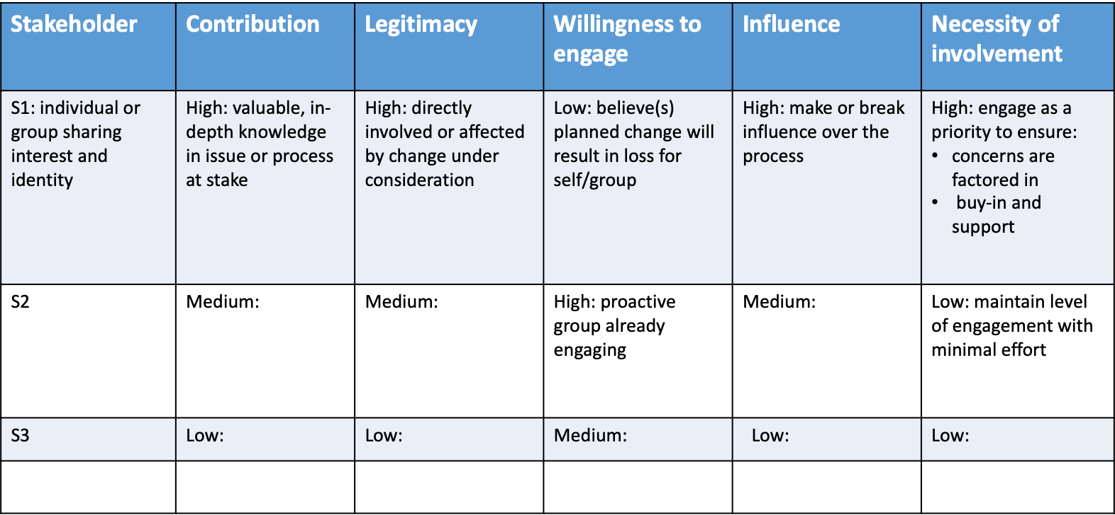
Political Analysis
Module 5: Identifying and Understanding Stakeholders
Notes:
The political goals and approaches of each stakeholder also need to be understood through the communication (strategic listening – as explained in Module 1) that will need to take place amongst stakeholders.
The tool in this slide helps to understand the interests, motivations, approaches and role of each stakeholder and identify where conflict can arise as a result of competing interests, perceptions, goals, approaches.
The contribution each can make should first be assessed and understood concretely.
The legitimacy that each enjoys from the at-risk populations they aim to engage is also key to understanding and assigning roles for the engagement strategy.
The level of willingness to contribute to the multi-stakeholder process, the willingness to contribute to prevention efforts and measures will affect the process in its effectiveness and efficiency.
How much influence each has is also important as those with a significant influence to sell a multi-stakeholder process and its customised approach in a given context can be leveraged across the team and will inform the negotiation and assignment of roles and responsibilities.
And each actor does not necessarily have to be involved in all interventions. The level of involvement can also be determined depending on the specific requirements of a given intervention, given a specific context, including political climate.
The first step here is to understand interests – and, to do so, we need to ask ourselves the following questions:
Are each stakeholder’s goals clear?
Are they acting in line with their core beliefs?
Do you understand the constraints they face?
Who/what are the key influences on them?
Is their behavior shaped by social norms?
The second step is understanding change – what space and capacity do people have to effect change? In turn, this generates a series of other questions:
Who is the decision-maker?
Are their key decision points clear?
Do they have potential coalition partners?
Is their framing of the issue likely to be successful?
Are they playing on more than one chessboard?

Slide 65
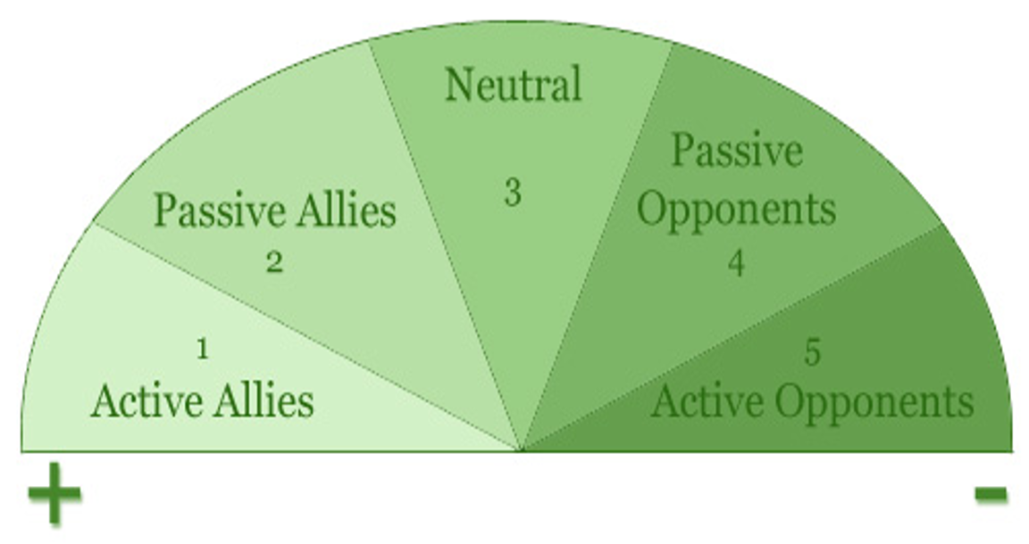
Mapping Attitudes Towards Change
Module 5: Identifying and Understanding Stakeholders
Notes:
It is also critical to map stakeholders in relation to: a) change in general; b) the reforms/initiatives you are advocating; and c) each other.
Understanding a stakeholder attitude toward a P/CVE, multi-stakeholder coordination/collaboration and other factors is also important to seek to understand.
Opponents may not necessarily be kept out as their contributions may be crucial to the effectiveness of the process. The engagement strategy of the less active allies will be different than for those who already understand the benefits of a team approach – a wide web of services and responses.

Slide 66
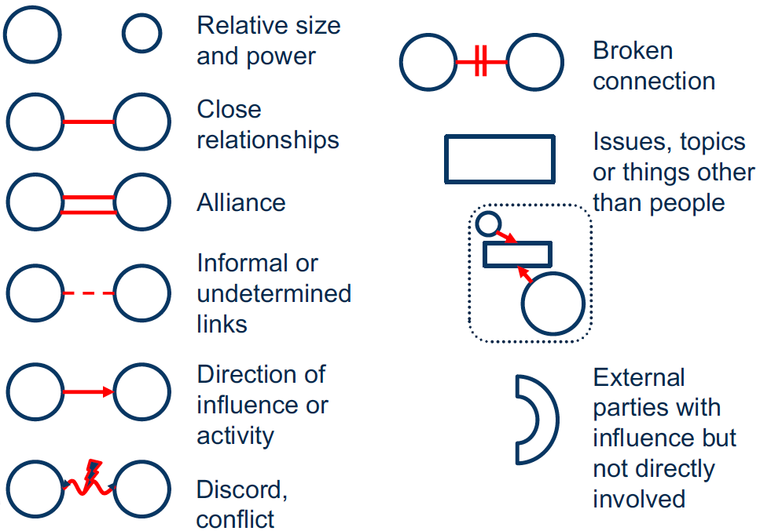
Mapping Stakeholder Relationships
Module 5: Identifying and Understanding Stakeholders
Notes:
It is not enough to understand which actors operate in a space and their respective attitudes to P/CVE, case management, use of force, etc. It is also important to understand how each actor relates to others and as a result what relationships exist between individual members in a given context.
Not all actors will have the same power and influence given their relationships with other government agencies, non-governmental organisations and other civil society stakeholders. The ability of each to engage in multiple fronts or to have developed credibility in the space of P/CVE interventions will play a large role in the development of a teams with various – ideally complementary roles.
If stakeholders are already working together closely and if they have established formal approaches to joint activities can lay the foundation for what works in terms of collaborative process in a given context. Identifying these can be useful.
The informal – and sometimes independent of P/CVE – linkages between stakeholders can also play a role in the collaboration as they will likely side with each other or share interests or views, at least from one standpoint.
The power dynamic between stakeholders should also be determined as it allows the group to understand who supplies the foundational resources, while others may engage at risk targets using these resources.
And if some don’t work together – have they in the past? What was the result of that collaboration? Can any discord/history/legacy be circumvented for a new collaborative process?
It is also important to identify if there are specific issues which may either plague or provide an opportunity for the collaborative approach to take hold? This can result from current events, cultural preferences, debates in a society, etc.
And finally, it is key to understand what other actors should be involved that are not already.

Slide 67
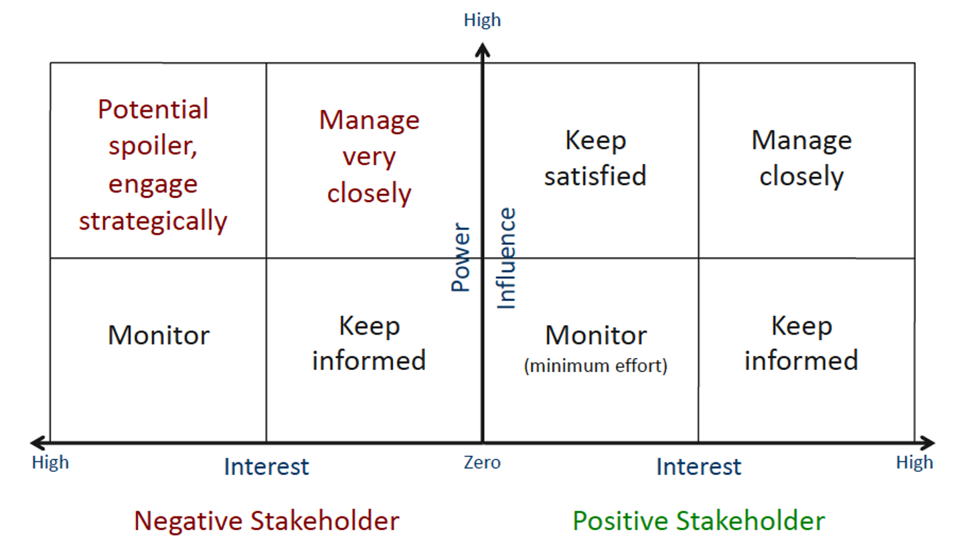
Engagement Strategy
Module 5: Identifying and Understanding Stakeholders
Notes:
Once all the mapping has been done and the relevant stakeholders who can make up a web of interveners are identified, those initiating a multi-stakeholder process now have the information they need to develop an engagement strategy to invite stakeholders not yet on the team.
This is what will be done in the following exercise for your specific context. This slide will be used for the exercise to develop an engagement strategy which includes the assignment/negotiation of roles and responsibilities.

Slide 68
Summary and Conclusions
Module 5: Identifying and Understanding Stakeholders
Identify the relevant actors who can make a contribution.
Understand what they can contribute and the limitations of their involvement.
Understand their interest and positions vis-à-vis P/CVE and multi-stakeholder interventions.
Understand existing relationships between stakeholders.
Develop an engagement strategy.
Understand how to encourage involvement of different stakeholders.

Slide 70
Module 6
Building a Multi-Actor Team

Slide 71
Introduction
Module 6: Building a Multi-Actor Team
Building a sustainable team is critical to complex problem-solving and solution development.
Multi-actor team diversity enhances P/CVE programme strength.
Multi-actor teams can fill resource limitations and gaps.

Slide 72
Goal
Module 6: Building a Multi-Actor Team
To understand how to build an effective, trust-based team to support a multi-actor P/CVE intervention programme.

Slide 73
Learning Objectives
Module 6: Building a Multi-Actor Team
Understand key approaches to establishing clear mandates, roles and responsibilities.
Promote transparency, trust and consensus-building.
Develop effective information-sharing among relevant actors.

Slide 74
Key Messages
Module 6: Building a Multi-Actor Team
P/CVE is a complex issue and requires a diversity of disciplines, resources, and capacity: no one agency, entity, or individual can do it alone.
A team-oriented approach is likely to be more effective than any single actor working alone.
However, the “team” concept can be operationalised in a variety of ways, depending on the local context.
Key elements to forming an effective team include – promoting transparency, developing trust, building consensus, clarifying roles and responsibilities and facilitating information-sharing among team members – and there are a variety of ways to incorporate these elements in a particular team.

Slide 75
Why Work as a Team
Module 6: Building a Multi-Actor Team
A team combines multiple skills, experience and diverse backgrounds.
A team gets better results than a collection of individuals working on their own.
A team is more flexible than a permanent structure or system.
A team is more productive because their members are committed to a common goal.
A team delivers results.
Notes:
An old African proverb states: “If you want to go fast, go alone. If you want to go far, go together”. When it comes to preventing or countering violent extremism, we recognise the vast complexities and the need to go far and thus together.
A team has been defined as a unique group with an objective and is characterised by collaboration being required for reaching the team’s goal. In the context of why we are all here, our objective is clear – it is to prevent and counter violent extremism. And it is through the collaborative effort in particular we put self-interests aside to address the issues surrounding or giving rise to violent extremism as one.
[Read the five benefits of working as a team presented on the slide].

Slide 76
Practitioners-Professionals Perspectives: Team Considerations
Module 6: Building a Multi-Actor Team
Family
Religious Leader
Coach
CSO
Former
Youth
Health
Counsellor
Social Worker
Teacher
Notes:
These are examples of the stakeholders that have typically been involved in delivering P/CVE interventions in different contexts, including as part of a team. Some of these may be relevant to your context; others may not be. There may still be others not on the slide that may be important to include from your community. [Ask participants whether these stakeholders are relevant in their context and whether there are others not on slide that are important to include].
Each member of any team should bring their own unique and valuable perspective, skills, understanding, abilities, and approach to the specific issue being addressed.
The composition of any team will depend on a number of facts, including the capacities and willingness of potential team members to participate, the needs of the relevant community, and the available resources.
As it will be addressed later today, depending on the existing capacities/resources and specific P/CVE expertise, some training and other capacity-building support may be required not only focussed on individual team members but on collaboration among them.

Slide 77
P/CVE “Teams”
Module 6: Building a Multi-Actor Team
Formal
Ad hoc
NGO
Frequency
Notes:
P/CVE teams can be formal (e.g., with each member signing a Memorandum of Understanding or based on a cooperation framework among relevant agencies and services providers, as in Denmark) or informal.
They can be more ad hoc, like the multi-disciplinary case meetings in The Netherlands, where municipal officials and local partners, which might include prosecutors, police, child protection workers, social welfare workers, security officials, and youth care centres meet on an as needed basis to discuss individuals showing signs of radicalisation to violent extremism.
They can also be led by an NGO, which relies on a loose network of practitioners or service providers to design/deliver the necessary intervention/s on an as-needed basis.
When it comes to frequency they can work together on a daily basis in a shared office space, as is the case with the ANCHOR Teams in Finland. Alternatively, team members can work for their separate organisations but come together at a shared (including virtual) table, often at a neutral space, on a periodic (e.g., weekly, monthly, or quarterly) or an as-needed basis to review cases. Regular face-to-face meetings, however, can be helpful in building the trust that will be critical to effective cooperation around the handling of individual cases.
The form a team might take typically depends on a number of factors. These include the number of cases, existing resources, and other capacities of the members (whether individuals or organisations) of the team, as well as the levels of trust that the members have within the relevant community and with each other.
Depending on the context, consideration could be given to limiting membership to a small number of stakeholders that are more likely to have broad institutional interests in the programme, with other actors involved on an as-needed basis.

Slide 78
Breakout Exercise
Module 6: Building a Multi-Actor Team
Instructions
Discuss and then answer the following questions:
Who should be part of the team?
What might be some of the challenges to getting them to participate and how can they be overcome?
What type of multi-actor team might work best for your community?
Notes:
[Participants will be divided into their preassigned groups to discuss and then answer the questions above. After 10 (if online) or 15 minutes (if in-person) of breakout discussions, participants will reconvene in plenary and debrief for another 10 (if online) or 15 minutes (if in-person). Participants should make use of the ‘ Worksheet for Breakout Exercise #1’ included in the module scripts for comment-tracking and guiding the discussion].

Slide 79
Roles, Responsibilities and Mandates
Module 6: Building a Multi-Actor Team
Purpose and focus Clarity of threat
Involvement and roles Leadership
Oversight and review Process of operations
Notes:
Given the diversity of stakeholders likely involved, clarifying their respective roles, responsibilities and mandates and ensuring team members share a common understanding of the key elements of the team will be important. These elements include:
The purpose and focus (e.g., various forms of violence or various forms of violent extremism or just a single form of violent extremism) of the team: gaining clarity on the nature of the threat that the team/programme is supposed to help address will be important.
Involvement and roles: who will be involved and what will be their respective roles? Critical here is which actor/organisation will lead the team.
One lesson learned from different multi-agency and multi-disciplinary mechanisms and other relevant programmes is that “one organisation should chair and coordinate the process and have final responsibility over the programme and outcome” (Ranstorp, 2016). Responsibilities of team lead might include coordinating the information-sharing process and decision-making about individual cases and have final responsibility over the programme and outcome.
The lead actor could be the municipality (e.g., the mayor’s office or a social welfare agency), a national government agency, the local police, or an NGO. In some cases, dedicated officers have been hired to manage the programme. In other cases, funding has been secured by an existing entity (e.g., certain municipalities in Canada) to enable it to hire staff to run the programme.
The decision on which organisation is best placed to lead should be informed by which organisation is likely to engender the most trust among the relevant professionals, practitioners, and community members.
Oversight and review: These elements could be elaborated in a founding charter, terms of reference, series of protocols, or another appropriate and transparent format. See MERIT/Ottawa for an example of how this is done.

Slide 80
Promoting …
Module 6: Building a Multi-Actor Team
Trust
Transparency
Consensus Building
Notes:
Building trusted relationships among team members, who are generally not used to working with or otherwise lack familiarity with each other, is typically critical to the team’s success. Delineating the role of each stakeholder at the very outset can be helpful for building trust. This might be particularly salient for reassuring those who might have some hesitation with being involved in a team that includes security actors.
One possible approach here could be to make it clear that while the team could accept case referrals from the police or other such actors, they will not be discussing individual cases with other members of the team and the team will not share information with the police, except when there is an imminent threat of violence or to national security.
What should be done when the necessary levels of trust may be lacking? One option could be to develop a team that, at least in its initial phase, relies only on those agencies and organisations where there is such trust (including with the target community) and other key stakeholders could become involved at a later stage, after the team is up and running.

Slide 81
Trust, Consensus and Transparency
Module 6: Building a Multi-Actor Team
Guiding Framework
Engaging Community
Leadership Selection
Advisory and/or Oversight Board
Joint Messaging
Notes:
This slide highlights some ways to strengthen trust, build consensus, and ensure transparency. Of course, there may be other activities not included here which may be relevant in your context. [Participants are encouraged to identify those]:
Develop a guiding framework: one option is to develop a framework, informed by input from primary/key stakeholders via a collaborative process, to guide the P/CVE multi-actor team. This provides clear direction about the purpose, intent, and direction of the team. It should also be made available publicly, where appropriate.
Engage the community: community forums or other means of engaging the community should be considered once the team members are identified and a guiding framework is produced. This can be an effective way to solicit public input on at least elements of any framework. The focus of this engagement should be on those who are most likely to take advantage of a P/CVE intervention programme (i.e., target beneficiaries and community members who might make referrals or contribute to assessments/interventions). Community forums should be held at a neutral location, such as a youth centre, library, or other community space.
Select the leadership: the leadership, much like the key and support stakeholders, of a multi-actor P/CVE team should be well respected and trusted both among team members and the community the programme is seeking to support. The leader should be familiar with the P/CVE subject matter.
Constitute and advisory and/or oversight board: accountability helps to foster trust and transparency. You should consider the creation of an advisory and/or oversight board with whom the P/CVE multi-actor team can consult with or receive guidance from once established.
Developing/implement joint messaging: communication is one of the most important aspects of any relationship – personal or professional, on an individual or organisational level. Given the different professionals, disciplines, and organisations that might need to be involved in a P/CVE intervention team, it is important to develop a consistent/coherent messaging strategy about the programme/team. This is so for both internal and external communications throughout the various stages of the multi-actor team’s existence and its operational activities: it helps reassure the public.
When developing a joint message, consider:
Focusing on common/shared, non-securitised terminology language and avoid jargon;
Avoid stigmatising and labelling language; and
Ensure it is a message of transparency, making clear what the objective/s of the team/programme are.

Slide 82
Information-Sharing Foundation
Module 6: Building a Multi-Actor Team
Frameworks can:
Outline
Elaborate
Protect
Define
Notes:
The effectiveness of a multi-actor team depends in large part on the extent to which they are able to share information about individuals who may be deemed to be at risk of violent extremism, while protecting the privacy of the relevant individuals.
Multiple actors – from mental health professionals, teachers, social workers, and family members – may have relevant information on a single individual, and that information will need to be reviewed as part of an assessment and included when designing an intervention or support plan.
There are different challenges to facilitating the necessary information sharing:
Different professional and ethical frameworks and goals.
Some actors may be reluctant to share information with agencies and organisations with which they do not typically co-operate and/or with which they have no legal basis for cooperation.
Some may have concerns about violating the privacy or data protection rights of the concerned individual. For example, the police or security services may be reluctant or unable to share information with actors that do not traditionally have access to sensitive, let alone classified, information. As a result, the default can be to find reasons (real or perceived) not to share.
In this regard, some form of transparent information-sharing guidelines to facilitate the sharing of knowledge, expertise, and appropriately protect information – which can enable the team to assess the individual case together effectively and safely – are needed. These frameworks, which come in different forms, can:
Outline when and with whom information can be shared.
Elaborate how shared information will be used and protected.
Help protect individual and data privacy and allay concerns that the police/security services, if involved, might use information shared with the team for intelligence gathering and law enforcement purposes.
Clearly define the limited instances when information on an individual case can be referred to the police (e.g., when there is a risk of imminent harm). Providing such clarity can help increase the willingness of members of the community to refer individuals to the mechanism while encouraging non–law enforcement practitioners and professionals to participate.
Any such framework could help “distinguish what is genuinely classified information and what is sensitive information […] that could be shared with some prudence” (EU Radicalisation Awareness Network, 2016). Where such clarity is lacking, then it can be difficult to instil the necessary trust.

Slide 83
Breakout Exercise
Module 6: Building a Multi-Actor Team
Instructions
Discuss and then answer the following questions:
Who should lead the team?
What steps could be taken to build trust and consensus among team members and ensure transparency?
What are the barriers to facilitating information-sharing among team members and how can they be overcome?
Notes:
[Participants will be divided into their preassigned groups to discuss and then answer the questions above. After 10 (if online) or 15 minutes (if in-person) of breakout discussions, participants will reconvene in plenary and debrief for another 10 (if online) or 15 minutes (if in-person). Participants should make use of the ‘ Worksheet for Breakout Exercise #2’ included in the module scripts for comment-tracking and guiding the discussion].

Slide 84
Summary and Conclusions
Module 6: Building a Multi-Actor Team
Be creative in the development of your teams.
Look to challenge “conventional wisdoms” about who can be part of the P/CVE team.
“We have always done it this way” is no longer acceptable when it does not create an inclusive team environment.
Trust can be built, repaired, and restored.
It is all about the people.

Slide 86
Module 7
Identifying Needs, Resources and Capacities of the Multi-Actor Team

Slide 87
Introduction
Module 7: Identifying Needs, Resources and Capacities of the Multi-Actor Team
Participants have learned about how to work in partnership and the basic concepts that underpin a multi-actor programme.
Designing a P/CVE programme is about bringing people together, but it is also about mobilising adequate resources.
Mapping, not only capacities and resources, but also gaps and needs, allows for fine tuning.

Slide 88
Goal
Module 7: Identifying Needs, Resources and Capacities of the Multi-Actor Team
To identify and understand how to best mobilise the necessary capacities and resources to support the development of a contextualised, multi-actor P/CVE intervention programme.

Slide 89
Learning Objectives
Module 7: Identifying Needs, Resources and Capacities of the Multi-Actor Team
Understand potential capacities, resources, gaps and needs.
Understand how to mobilise adequate resources, so that the team can meet its objectives.
Identify resources and priorities necessary for the overall commonly-stated objectives of the team.
Notes:
[Read the learning objectives on the slide out loud].
It is important to address not only the programme's strengths but also its weaknesses – what we are good at and what we are not so good at. The use of the word “potential“ in the first bullet point implies that we are not looking at the programme as a finished product, but as a work in progress – that leaves room for improvement.
Programme resources should match its objectives, as simply as that. It is pointless to have an abundance of resources if they are not properly used. This module will help us better understand how to make the best possible use of the resources available in our countries/localities.

Slide 90
Capacities and Resources
Module 7: Identifying Needs, Resources and Capacities of the Multi-Actor Team
What do we mean by ‘capacities and resources’?
Material Resources:
Infrastructure
Human
Financial
Etc…
Other Resources:
Skills
Disciplines
Expertise
Etc…
How to optimise resources?
Resources are always limited!
Notes:
The material resource component is quite self-explanatory. As for other resources (including expertise), designing a multi-actor intervention programme is quite a specific task, in the sense that it usually brings together experienced professionals, whose activity will not change drastically because of the subject. Professionals are sometimes concerned, if not afraid, that radicalisation and the “securitisation” that comes with it will force them to alter their practices.
In fact, a social workers, or a teacher, or a religious leader will typically intervene in their own capacity. At the same time, they may have to adjust their professional practices to a new, specific, and complex subject. For example, it is useful, if not necessary, for a social worker to have some knowledge of religion and how religion is used by extremist groups, whereas in other circumstances a social intervention can be delivered without taking religion into account. So even if professionals/practitioners do have a solid base to build on, they still need to acquire new and specific skills.

Slide 91
Material Resources
Module 7: Identifying Needs, Resources and Capacities of the Multi-Actor Team
The Infrastructure
How can we leverage a pre-existing programme from an adjacent field?
The general consensus: better to leverage a pre-existing programme/structure than to establish a new one.
Other possible intervention programmes:
Trafficking in human beings
Gender-based violence
Protection of vulnerable children
Etc…
Notes:
International good practices emphasise that, when designing a P/CVE intervention programme, it is more efficient and effective to set up a more general structure, or leverage a pre-existing intervention programme, than to create a new and specific one. The advantages of using a pre-existing programme include:
Already-existing community support;
Results have already been produced, and may have even been evaluated;
Administrative staff and other costs can be shared, and thus reduced;
It helps to avoid the stigma that usually comes with the words “radicalisation” and “violent extremism”.
Developing a sui generis programme will likely require more resources. If anything, they should at least use lessons learned and best practices from other programmes.

Slide 92
Material Resources
Module 7: Identifying Needs, Resources and Capacities of the Multi-Actor Team
The Infrastructure
How can we leverage a pre-existing programme from an adjacent field?
What programmes are currently available, including hotlines or helplines?
How effective are these programmes?
Which available for juveniles and which are for adults?
Can these programmes handle more workload?
What are the risks that adding a P/CVE component to an existing, functioning intervention programme will undermine such a programme?
Notes:
When looking at existing programmes, do not forget to consider existing hotlines and helplines.
There are few questions that should be considered as well:
Have these programmes been evaluated? If so, how and by whom? What are the results? Leveraging a proven programme is more important that choosing a programme that is "inherently" close to P/CVE.
Are the programmes easily and locally accessible? Are they known to the general public?
Imposing more workload onto an already packed programme creates tensions. If the chosen programme cannot handle more workload, resources must certainly be reevaluated, or objectives adjusted.
Typically, will the new P/CVE component be accepted, will it be consistent with the rest of the programme, or will it jeopardise and even "corrupt" the pre-existing programme? Will it alter an otherwise positive image?

Slide 93
Material Resources
Module 7: Identifying Needs, Resources and Capacities of the Multi-Actor Team
What other resources will the programme need?
Human resources: staff, secretariat, contributors…
Financial resources: travel expenditures, working time…
Other resources: office, meeting room/s, Internet connection…
Who or which authority can provide?
Notes:
Since programmes will vary in scope and shape, the needs (e.g., how many dedicated staff (if any), how big of an office (if any), budget) will vary as well.
In addition to identifying the resource requirements, consideration needs to be given to the question of which authority, institution, and/or organisation will be responsible for mobilising the resources. This can be a shared responsibility depending on whether there is one leader or several co-leaders of the initiative.

Slide 94
Breakout Exercise
Module 7: Identifying Needs, Resources and Capacities of the Multi-Actor Team
Instructions
Do you contribute to an already existing intervention programme from another field? If so, describe it briefly, including:
Name and field / subject/s
Level
Point of entry
Structure
Lead implementer
Service providers/partners

Slide 95
Skills / Expertise
Module 7: Identifying Needs, Resources and Capacities of the Multi-Actor Team
The many faces of radicalisation
History
Ideology
Social
Geography
Economics
Identity
Politics
Religion
Mental Health
Legal
Gender
Generation
Security
Family
Notes:
As it was discussed earlier in this course, radicalisation to violent extremism is a complex and diverse phenomenon.
This slide is a symbolic representation of its complexity and diversity. The size of the bubble is not a representation of a cause's importance, nor is this list definitive. The colours of the bubbles have no meaning. In theory, all these aspects can play a role in a radicalisation process. But in practice, absolutely no programme can tackle all these aspects simultaneously. So the objective is not to have an all-encompassing programme, but to identify and mobilise whatever skills are actually necessary to maximise the likelihood of success in a certain context. In virtually every context, however, the programme is likely to need to be able to rely on a wide range of skills and disciplines.

Slide 96
Skills / Expertise
Module 7: Identifying Needs, Resources and Capacities of the Multi-Actor Team
What skills/expertise are needed, which ones are already available, which ones need to be enhanced, and which ones need to be developed?
A six-step process
Notes:
The programme should be able to provide or facilitate the interventions/services that can address the vulnerabilities and needs most likely to present in the target communities. As such, it needs to be able to rely on a wide range of skills and disciplines. There are a number of steps to take to determine what skills/expertise will in fact be needed, which ones are already available, which ones need to be enhanced, and which ones need to be developed. We have identified six steps.

Slide 97
Skills / Expertise
Module 7: Identifying Needs, Resources and Capacities of the Multi-Actor Team
Understand the vulnerabilities to VE in the relevant communities and thus the needs that will likely be present.
Identify which existing professionals and members of the community might be best placed to intervene and address the spectrum of vulnerabilities.
Identify relevant capacities (and willingness) of the interveners to address the spectrum of vulnerabilities.
Identify expertise and other local capacity gaps.
Identify actors who might be willing to participate in a multi-actor programme.
Determine on what basis they would be willing to participate.
Notes:
First, understand vulnerabilities and needs. The radicalisation of a group or individual is always dependent on the environment. Vulnerabilities may include lack of identity, feelings of exclusion or injustice, tensions between communities, discrimination, poverty and inequalities, limited access to health services, controversial political decisions, presence of extremist groups, exposure to state violence, corruption, etc. Precise knowledge of the context is here essential.
Secondly, identify relevant professionals/community members, e.g., social workers, teachers, health care workers, religious leaders, mentors. Who is best placed to deliver P/CVE interventions or services to address the spectrum of vulnerabilities that are most likely to exist in the target community/communities?
Thirdly, identify relevant capacities. For example, are there concerns about dealing with higher-risk individuals and being associated with a heavily securitised topic? A multidisciplinary approach involves more than including professionals from different fields and backgrounds in the programme. These actors need to have both capacity and willingness to communicate with each other and develop a common understanding of radicalisation and violent extremism. Keep in mind that mutual understanding will likely take time to develop.
This can imply those professionals involved in the programme gaining some understanding of the other disciplines, which they may not be familiar with, so they can develop a common language. Effective communication among team members may necessitate first developing a shared understanding of the social, mental health, ideological, and security aspects of radicalisation to violence.
Fourthly, identify expertise and other local capacity gaps and whether there are capacities in other parts of the country that could be leveraged to address them.
In fifth place, identify actors who might be willing to participate. These include front-line practitioners, professionals, and organisations. Some may be willing to be “members” of the team; other may prefer an ad hoc role.
Finally, determine on what basis they would be willing to participate. Will they be willing to participate on a pro bono basis or will they require payment for this additional work? In general, professionals are more likely to participate if they feel that the P/CVE programme that is being put into place is fully consistent with their mission and values.

Slide 98
Training / Capacity-Building
Module 7: Identifying Needs, Resources and Capacities of the Multi-Actor Team
Will participants in the programme require training?
Different types of training/capacity building:
Initial vs. ongoing
Single stakeholder / profession vs. multi-stakeholder / profession
Introductory / advanced / specialised
Training / mentoring / exchange of experience
Notes:
Will participants in the programme require training? The short answer is, of course, yes, but the training and other capacity-building needs will vary depending on the local context. There are different types of training:
Initial vs. ongoing: initial here means at the onset or even prior to the launch of the programme. Ongoing training can sometimes create schedule conflicts and otherwise conflict with personal agendas.
Single stakeholder vs. multi-stakeholder: single-profession training allows for very specific training, while multi-profession allows for comparison, teaches collaboration, and can create solidarity between participants.
Introductory vs. advanced vs. specialised: introductory training can include teaching basic knowledge about violent extremism/radicalisation and P/CVE, while more advanced training can focus on a particular tool or approach. Specialised training can focus on a very specific aspect for a particular profession (for example, how to approach P/CVE intervention in child protection for social workers).
Training/mentoring/exchange of experience: training can also take the form of mentoring by another professional, organisation, or institution, as well as the participation in a national or international network of practitioners (for example, the EU Radicalisation Awareness Network).

Slide 99
Training / Capacity-Building
Module 7: Identifying Needs, Resources and Capacities of the Multi-Actor Team
How to adjust training to the specific needs of participants?
Some examples of expressed needs in P/CVE programmes for:
Front-line practitioners (in general): violent extremism/radicalisation, ideology, symbols, behavioural signs, how to engage, how to conduct an assessment, etc…
Mental health workers: trauma-informed care, how to work with religious leaders, etc…
Social workers: how to engage in difficult conversations, etc…
Notes:
Needs for training/capacity-building will likely vary depending on the type of practitioners involved. For example:
Front-line practitioners may require training on violent extremism/radicalisation, including its ideological components, and how to recognise symbols used by violent extremist groups to recruit; on how to identify behavioural signs of violent extremism and radicalisation to violence; on how to engage both off- and on-line with individuals who feel a growing sense of marginalisation or injustice; and on how to conduct a risk, needs, and vulnerabilities’ assessments.
For example:
Mental health workers may require training on how to deliver trauma-informed care and how to work with religious leaders to better understand an individual’s context, including as it might relate to being vulnerable to extremism violence radicalisation or recruitment.
Social workers may require training on how to engage in difficult conversations or with those who may present some level of security risk.

Slide 100
Training / Capacity-Building
Module 7: Identifying Needs, Resources and Capacities of the Multi-Actor Team
How to adjust training to the specific needs of participants?
Some examples of expressed needs in P/CVE programmes for:
Community members: behavioural signs, what and how to report, etc.
Decision-makers: basic understanding, strategic planning, multi-actor cooperation, etc…
A shared need: multi-actor cooperation
Notes:
Community members may benefit from basic guidance on what to look for in terms of behavioural signs of violent extremism and when, where, and how to report concerns.
Decision-makers: may benefit from a gaining a general understanding of radicalisation and violent extremism, human rights-based approaches to addressing them, and how to articulate and coordinate different public policies (e.g., P/CVE, gender equality, discrimination, etc.).
P/CVE training programmes are sometimes criticised for being too theoretical and not practical enough. Many of them do not focus on multi-actor cooperation. In fact, too often, developing collaborative approaches is taken for granted. One exception is the “Hexagon” training offered by the Centre for the Prevention of Radicalisation Leading to Violence in Montreal.

Slide 101
Breakout Exercise
Module 7: Identifying Needs, Resources and Capacities of the Multi-Actor Team
Instructions
Building on the previous discussion, which identified existing intervention programmes in your particular context:
Discuss the pros and cons of leveraging these programmes for the purpose of developing a multi-actor P/CVE intervention programme.
Identify these programmes’ most significant material and other capacities and resources.
Similarly, identify what additional ones, as well as any training and other capacity-building support, are required.
Identify one or two priorities: Where would you start? E.g., hiring staff, buying computers, organising a training course.
Notes:
[Let ideas flow, but please keep in mind the central question: how to develop and operationalise a P/CVE intervention programme in the relevant local context? This discussion should help answer this question].

Slide 102
Summary and Conclusions
Module 7: Identifying Needs, Resources and Capacities of the Multi-Actor Team
What have we learned?
What we are good at, and what we are not so good at.
There are many aspects to consider when it comes to resources.
Let us not reinvent the wheel: make use of existing opportunities.
We need many disciplines and fields of expertise.
Training and capacity building are key.
Keep in mind: (almost) no programme is ever 100% adequately resourced!

Slide 104
Module 8
Developing a Case Intake and Management System
Notes:
This module will have an operational focus looking at referral mechanisms, initial assessments, defining P/CVE cases, and wider factors in effective case management.
The module will be looking at a number of case studies across the EU and be asking participants to consider these case studies and how they may be applied to the local context.

Slide 105
Introduction
Module 8: Developing a Case Intake and Management System
Overview of content:
Importance of case management in P/CVE.
Referring and recording principles and processes.
Reviewing and screening referrals.
Management and disposal options.
Notes:
This is very much an operationally focused module, where we will discuss why case management of P/CVE cases is important.
We will also build upon understanding of:
The relative strengths and weaknesses of referral options that may be considered in how to refer P/CVE cases to a multi-actor programme.
Involvement of civil society organisations and other agencies including the police.
Undertaking an initial assessment, deciding what a P/CVE case is, and how that case is managed practically through to eventual disposal.

Slide 106
Goal
Module 8: Developing a Case Intake and Management System
Understand principles of shared case management of P/CVE cases.
Notes:
The objective for this module is to understand the principles of effective case management for P/CVE cases from receipt to final disposal.

Slide 107
Learning Objectives
Module 8: Developing a Case Intake and Management System
Identify and build upon participant’s knowledge and understanding to be able to develop an effective shared case management system.
Identify the appropriate referral mechanisms for the team.
Understand how to work together conduct a thorough initial multi-actor assessment.
Develop a P/CVE case identification approach adequate for the local context.
Notes:
By the end of the module, you will:
be able to identify the most appropriate referral mechanism for your context and the advantages and disadvantages of different approaches; and
better understand the principles of initial assessment as to whether a case is a P/CVE case and the options for management and disposal in a multi-actor setting.
The module will use case studies and exercises to bring out discussion points.

Slide 108
Why is Case Management Important?
Module 8: Developing a Case Intake and Management System
Auditing
Measuring Impact
Risk Management
Enables Multi-Actor Participation
Confidence in the System
Accountability
Response Coordination
Consistency
Regulatory Compliance
Confidentiality
Effective Early Intervention
Information Sharing
Notes:
[The content of the slide will be hidden at first – it should be exposed at the end of the facilitated discussion].
[Familiarise yourself with the content of the slide prior to commencing the discussion. Then pose relevant questions to participants to draw out the key points on the slide (e.g., why do we need to have a case management process?)].
[There is no particular order to the points on the slide and there may be others that may be drawn out in the discussion which are not shown. It is considered these may be the most important but not exclusively so].

Slide 109
Breakout Exercise
Module 8: Developing a Case Intake and Management System
Instructions
Take 10 minutes to discuss and then answer the following questions and justify why you came to your decisions:
Who should a referral be made to?
How should a referral be made?
What should be referred and why?
Notes:
[This is a small group exercise to draw out thoughts on referring P/CVE cases. The key learning points that need to be brought out in this session are:
Various options are available in terms of referral mechanisms which should fit the local context. What works already locally?
Role of civil society can be important in building trust.
Role of the police – if so, when?
The importance of the wider team in making decisions and the links between team members in ensuring a joined-up approach at the initial stages.
Break participants into their preassigned groups and allow them to discuss the three questions. The plenary is the most important point for drawing out the nuances of approaches].

Slide 110
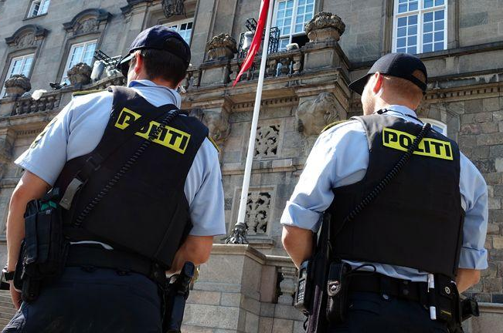
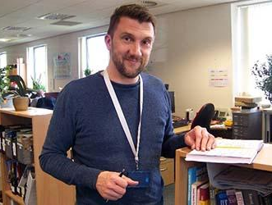
Referral
Module 8: Developing a Case Intake and Management System
Who should the referral be made to?
Notes:
[Facilitate discussion on answers across the groups. The key points to draw out are:
What is there locally already? Who has capacity? Who has capability?
Galvanise response through one suitably qualified actor who is part of the wider, local, multi-actor team and who can provide a focal point according to the local context.
Increased public health approach as opposed to law enforcement.
Police are not ideally placed to be the first point of receipt although they can be the source of the referral.
The team member receiving may either conduct a screening assessment or involve a wider multi-actor team].
[Discuss the following as options for recipient of referral:
Social workers.
Faith centres.
Youth workers.
Local community groups.
Teachers.
Health/Mental health.
Other local options based on existing local processes].
[Discuss the impact of police involvement including that this is the non-criminal space and the negative connotations that an overreliance on the police could have. The key points to draw out are:
Incentivise the use community referrals.
Community referrals have less risk of disproportionate response.
Community referrals contribute to building trust and incentivise multi-actor participation].

Slide 111
Referral
Module 8: Developing a Case Intake and Management System
What are the best methods of making a referral?
E.g., hotline, website, email, community contact…
Notes:
[Facilitate discussion on answers across the groups. The key points to draw out are:
What currently works?
What could be better?
Are there any parallel processes that can be used?
What is in place in the participants’ localities already?]
[Clarify that choosing the right method of making a referral is important. It should account for matters like:
Confidentiality.
Possibility of submitting anonymous referrals.
Accessible for the community.
Takes into account juvenile/adult, as well as gender considerations.
Considers social media options].

Slide 112
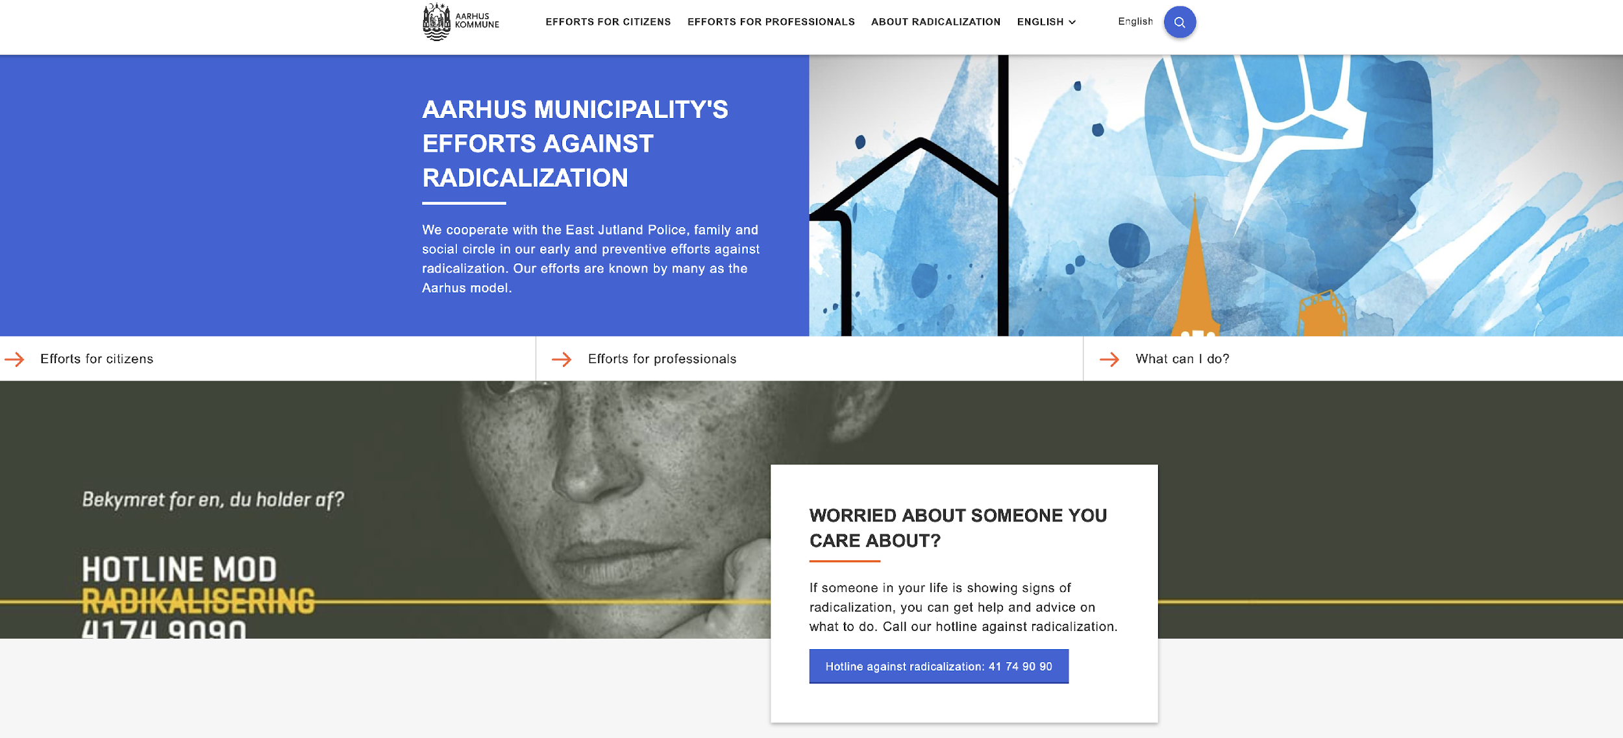
Referral
Module 8: Developing a Case Intake and Management System
What should be referred?
Notes:
[Facilitate discussion on answers across the groups. The key points to draw out are:
Stress that this is P/CVE – the non-criminal space. If this is a criminal activity, then the police may need to be involved.
Concerns.
Need for advice.
Early intervention.
Prevention].
This is focused on the prevention of violent extremism and is not a substitute for other types of referral. Recording incorrectly can lead to mistrust of the system by the community and those seeking support.
Other types of referral may need to be signposted elsewhere or managed differently. However, it is also accepted that referrals may also be managed within settings that manage other types of casework, e.g., drugs, gangs.
It is also important to strike a balance between encouraging referrals and ensuring correct referring. This is dependent on communication, publicity and training and is potentially a longer-term goal as the programme progresses. What is also important in managing referrals is that feedback is provided to those referring particularly when the referral is wrongly made.

Slide 113
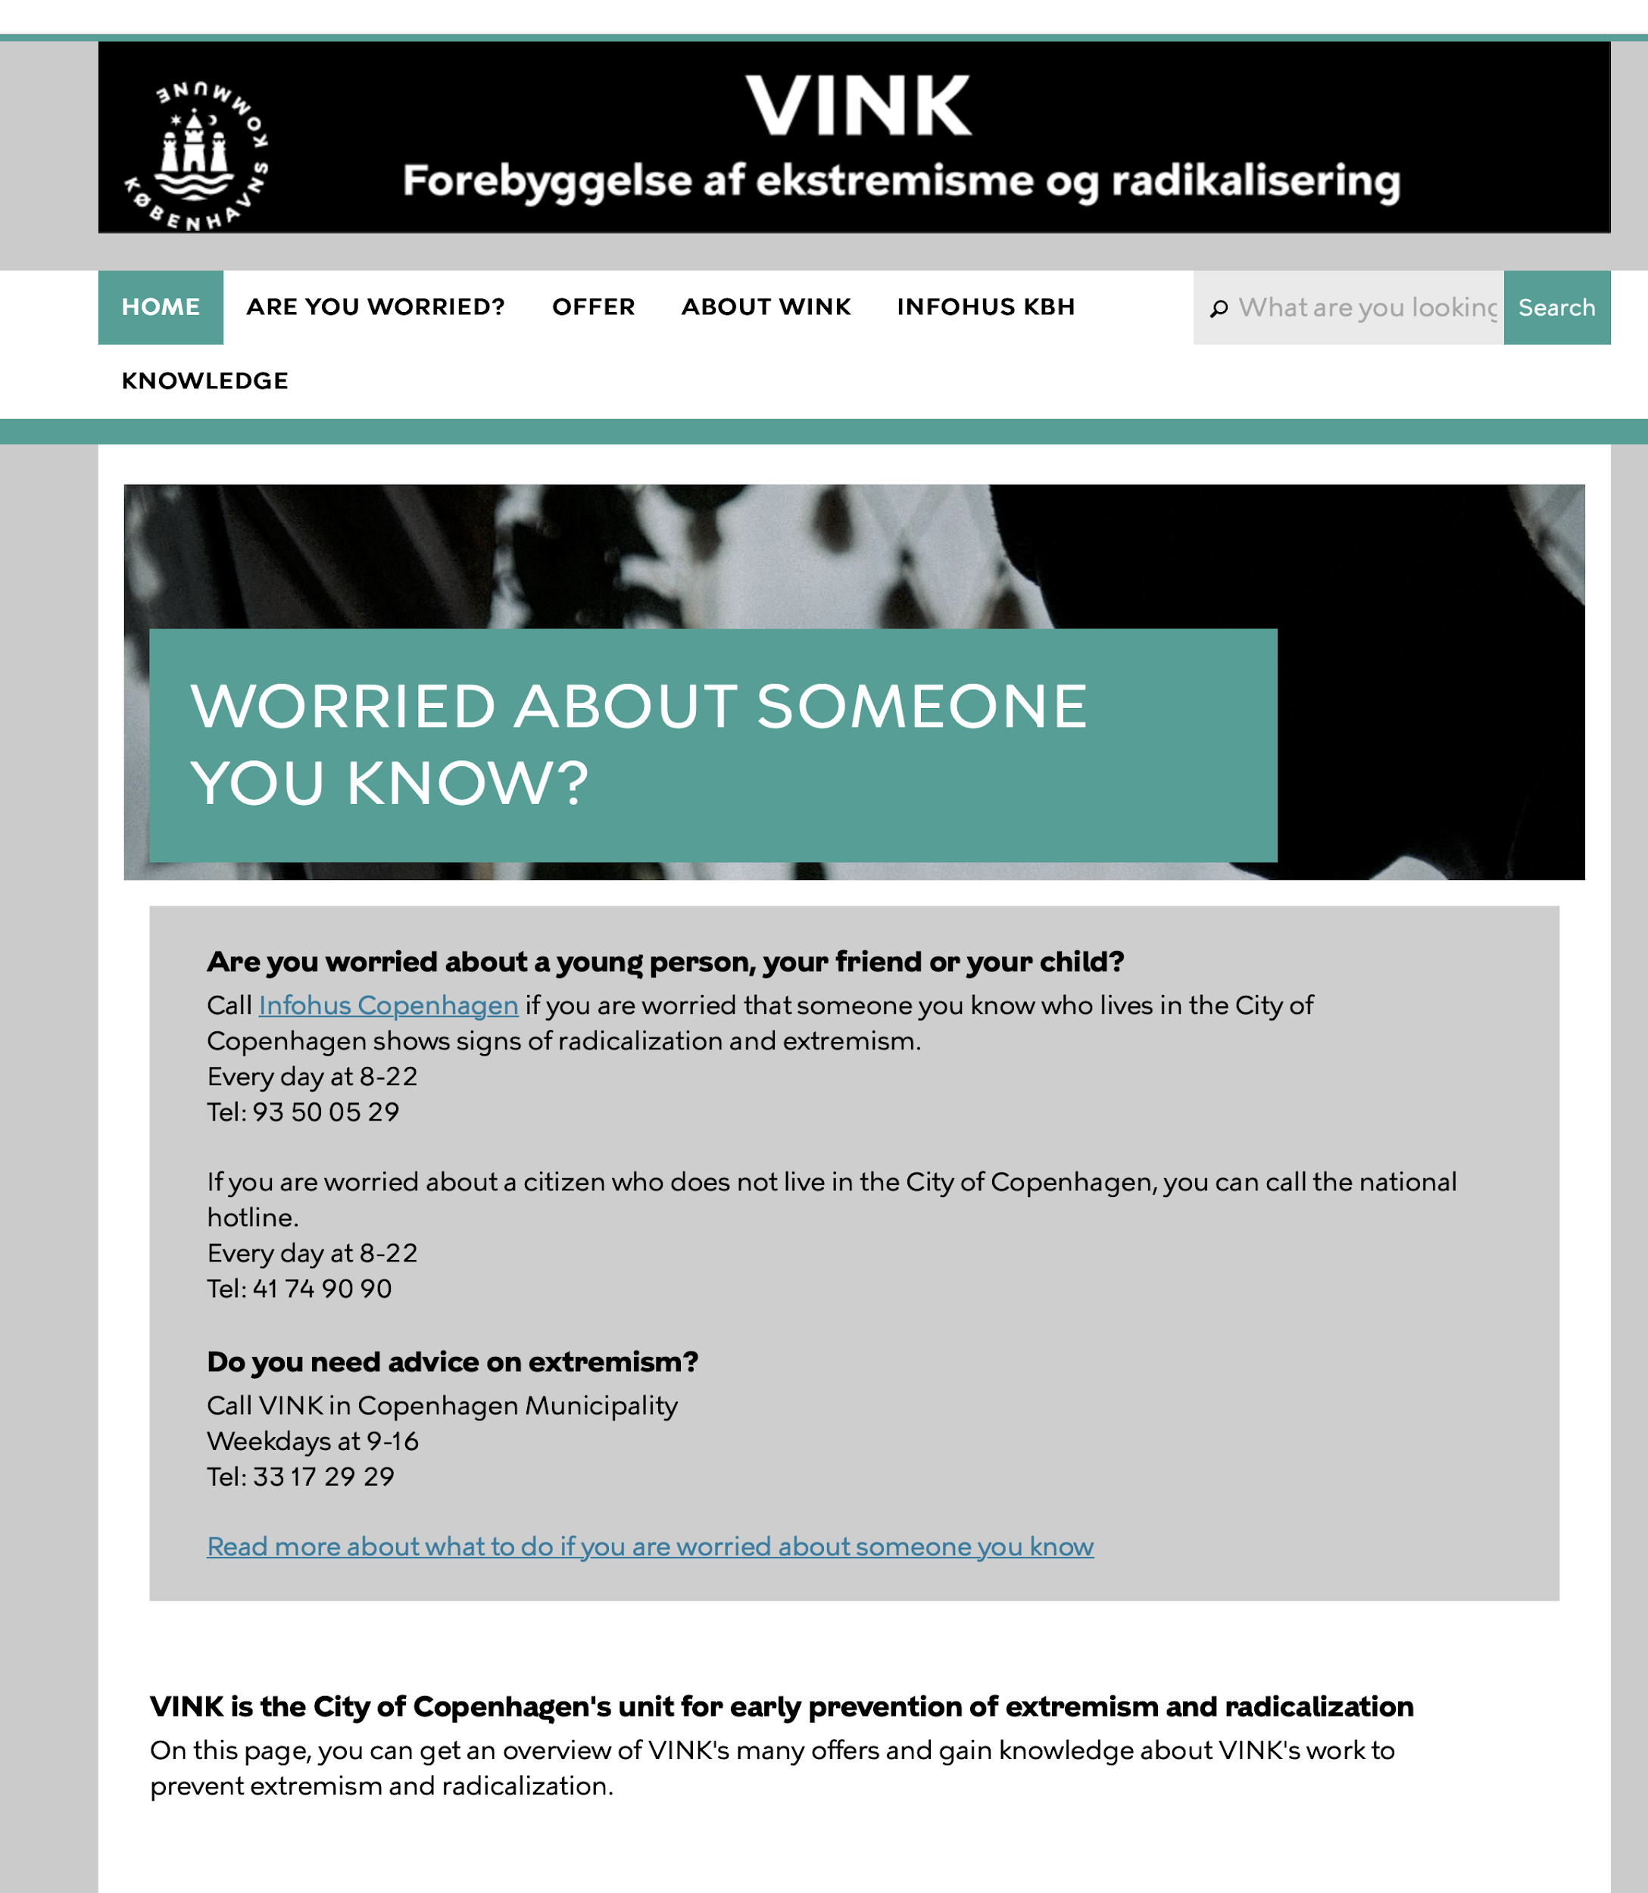
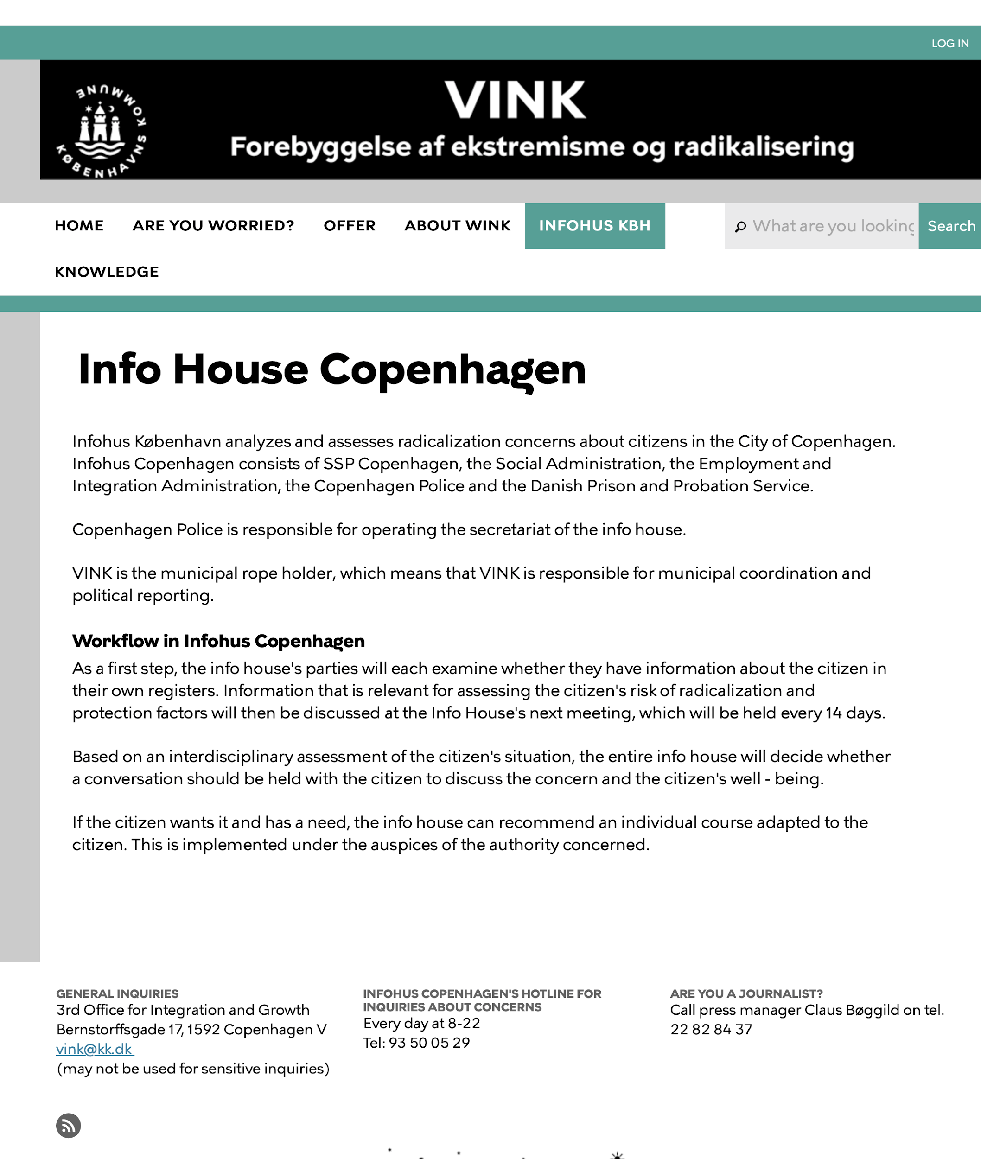
Case Study 1 – Copenhagen
Module 8: Developing a Case Intake and Management System
VINK – Provides contact for P/CVE advice in Copenhagen.
Comprising of radicalisation practitioners, street workers, mentors, and teachers.
VINK part of Copenhagen Coordination Unit/Info House.
Info House membership also includes social services, police, probation.
Meets every 2 weeks to discuss casework.
(VINK, n.d.)
Notes:
VINK-project (Knowledge – Integration), Copenhagen:
The VINK project is a key member of the ‘info-house’ crime-preventive collaboration where the key actors are the police and the municipalities, but with other key authorities such as the schools, regional mental health, and the prison and probation services involved. It was established in 2009 as an independent initiative by the Municipalities of Copenhagen for early prevention of extremism and radicalisation.
The VINK unit comprises a multi-agency group of experts and practitioners, including frontline and street workers, youth support teams and mentors, teachers, people with a strong knowledge of extremist movements and radicalisation, and those from minority backgrounds. The aim of the initiative is to offer advice to municipal workers and concerned citizens who are in contact with young people vulnerable to radicalisation. Beneficiaries are teachers and social workers who work with youth aged from 14-20 years, with a focus on labour and employment.
VINK helps through counselling and offers opportunities for dialogue with experts using an evidence-based approach. However, the project’s main support is offered by telephone.

Slide 114
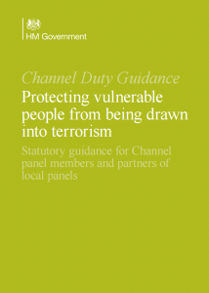
Case Study 2 – United Kingdom
Module 8: Developing a Case Intake and Management System
All referral to social services and police for initial assessment/information-sharing.
Statutory agency focus.
Multi-agency panels in each municipality discuss casework.
Comprises of social services, health, police, and probation, but led by municipality.
Are required to meet monthly.
Process and responsibility determined by UK law and overseen by central government.
(Home Office, 2015)
Notes:
[Compare to the previous Danish case study and involvement of civil society from the start].
The UK response and case management is determined by a national legal framework which defines roles for agencies with the police being central to the initial decision assessment as to progression of case. The UK Home Office oversees the programme to ensure consistency of approach and compliance – The Home Office is responsible for national security in the UK.
It is a “top-down” approach with national guidance underpinned by law. Police have a duty to assess the counter terrorism threat initially. All referrals are initially assessed and triaged by the police albeit may not be received by the police directly. Once initial assessment has concluded then the referral will be passed to a multi-agency panel for further assessment by professionals/specialist intervention providers. These panels are mandatory and enshrined in law.
There are multiple entry points and methods of referring and the police undertake all recording on a national database.

Slide 115
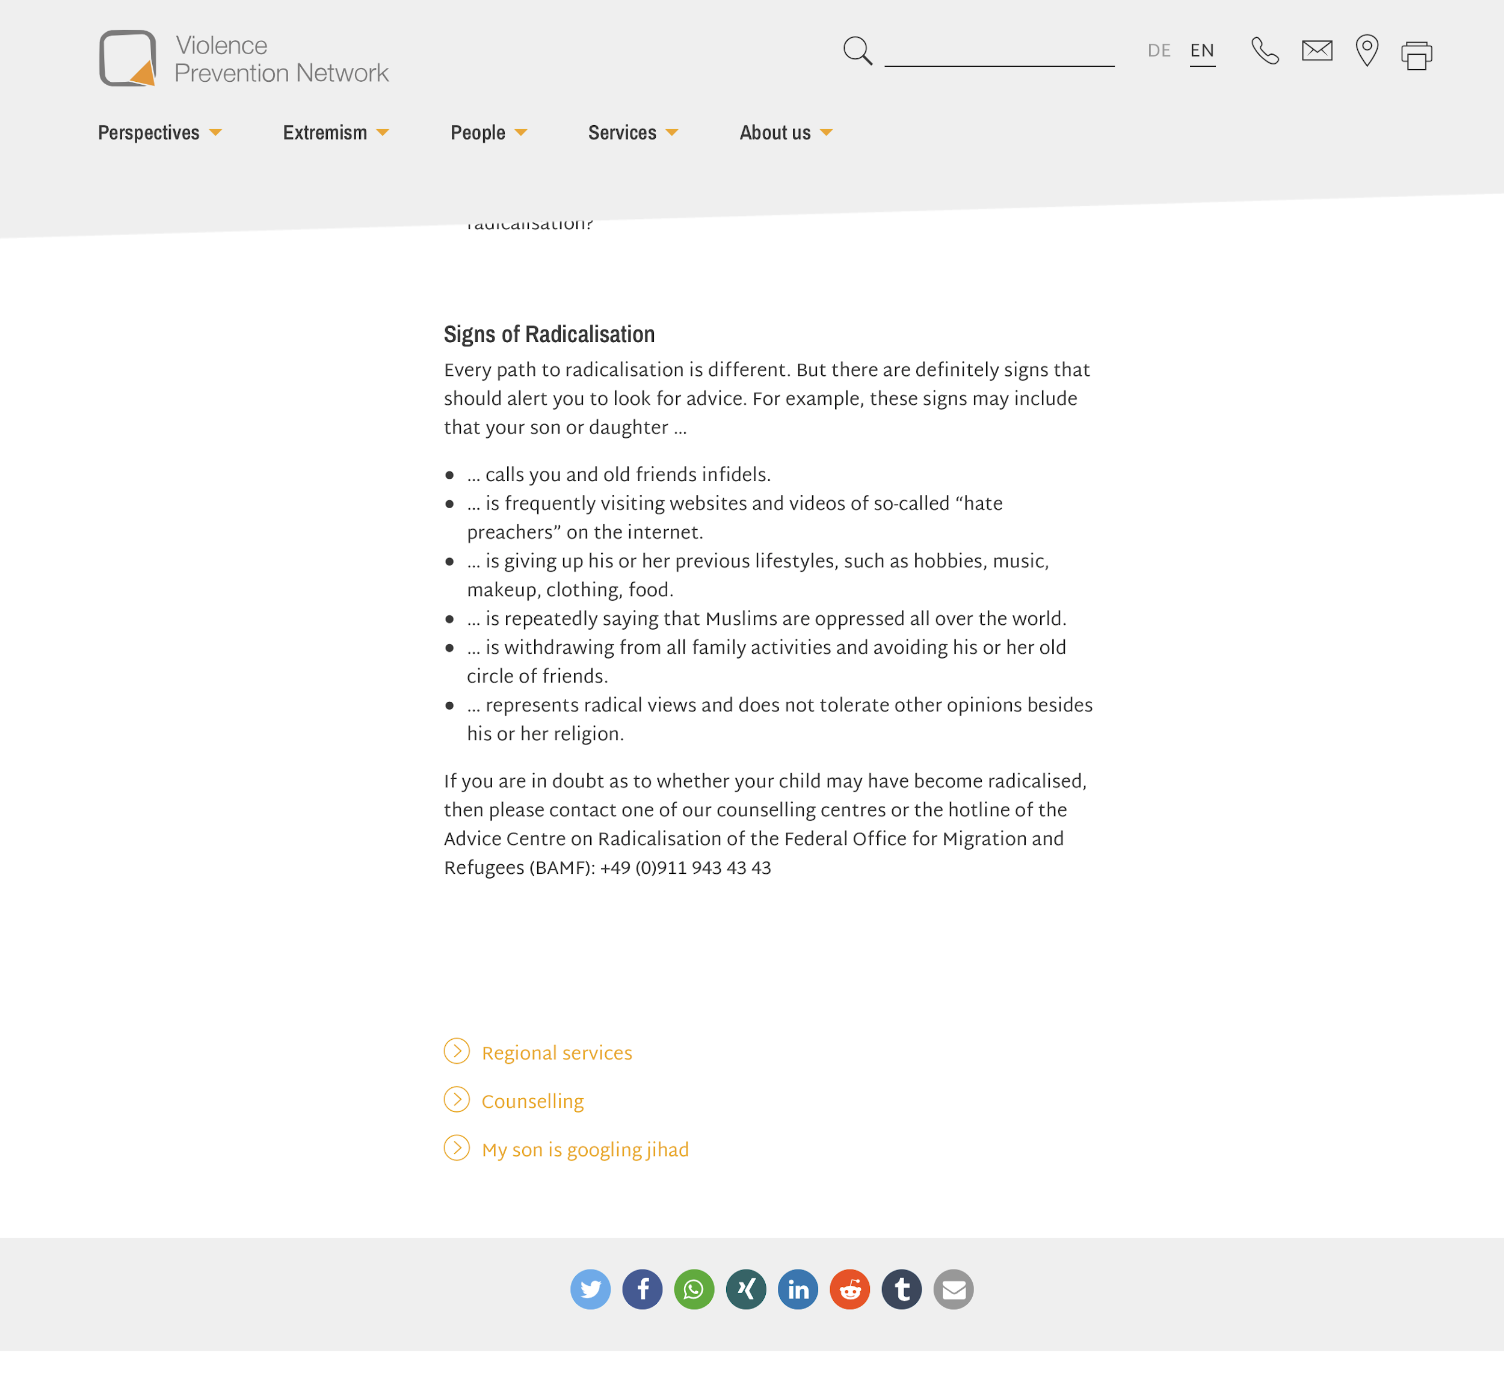
Case Study 3 – Germany
Module 8: Developing a Case Intake and Management System
Violence Prevention Network (VPN) is an NGO providing local grassroots support to families in various states in Germany.
Part of a network of NGOs subsidised by the German federal government.
Provide specialist services, working directly with those believed to be vulnerable to extremism.
Highly flexible approach.
The NGO shares experiences across the network to ensure continual learning and development.
(Violence Prevention Network, n.d.)
Notes:
[Compare to previous Danish and UK models].
The Federal government in Germany set up a hotline for referring radicalisation concerns in 2011. The hotline operator undertakes an initial assessment and refers relevant calls to local NGOs. This is complemented at a local level with the NGOs operating local hotlines to ensure wide reach into the community at a national and local level.
Local NGOs have the ability to adopt a flexible approach depending on local needs. The NGOs have specialist skills in youth work, violence prevention, and wider public service support. Violence Prevention Network (VPN) is one of these NGOs providing grassroots support and advice to the community on radicalisation issues.
VPN has a direct relationship with the police but will only involve them if the client will hurt themselves or others or the criminal threshold is reached. Clients are informed of this from the outset to build in trust and a long-term working relationship.
[Compare the role of NGOs, police and other agencies, as well as legal frameworks, among the 3 case studies].

Slide 116
Initial Screening
Module 8: Developing a Case Intake and Management System
Is this connected to violent extremism?
Does the individual have a vulnerability?
Information may be minimal
Meet with individual?
Voluntary participation
Should the police be called? If so, when?
Family
Social Care
Police
School
Health
Friends
Subject
Notes:
There needs to be a link to violent extremism and a vulnerability/need for the referral to be considered a P/CVE matter. Not all referrals become a case and this stage should be used to screen referrals.
The screening decision may be made by a suitably trained and experienced single organisation or as part of a wider team function. Existing local practice, capacity and capability may inform this. This is a vital and critical step in terms of the subsequent management of the case.
This step is the initial screen as to whether a referral is a P/CVE matter It is not designed to assess the detailed vulnerabilities and needs of a client and the possible intervention. This will be covered in the next module. This initial assessment determines whether the case has been correctly referred (not malicious or misguided).
Correct decisions are important in establishing trust in the process and ensuring there is a proportionate and correct response to deal with the needs of the individual. In order to assess this, there needs to be as much information as possible at the initial stage and this may include a conversation with the subject or their family or other key actors/agencies. However, this may be limited, and decisions may have to be made with little information.
Early contact with the subject helps build trust and confidence going forward and the agency that does this is therefore important. Police involvement at this stage may be counter-productive. Contact should be made by whoever is best placed and has the relevant skills/experience, e.g., if there is ongoing support with a social worker or key community member.

Slide 117
Breakout Exercise
Module 8: Developing a Case Intake and Management System
Instructions
Take 15 minutes to discuss and then answer the following questions and justify why you came to your decisions:
Eight ‘initial assessment’ case studies:
Is the referral a P/CVE case?
What further information may be needed?
Notes:
[Divide participants into their preassigned groups, distribute the case studies included as an appendix to the scripts for Module 8, and ask each group to decide whether each case is a P/CVE case and their rationale. There is no other information available to assist the decisions.
The groups should apply the simple test of “is this extremism?” and “is this a vulnerability or need on the part of the person?”. Decisions will be discussed in the plenary. Take a poll for each case and then select a group to justify their decisions and see if there are any other views/conflicts.
The number of cases for this breakout exercise can be determined to suit the timescales. The answers provided for the cases are guides and may not necessarily fit the local context, so there may need to be a flexible approach].

Slide 118
Management
Module 8: Developing a Case Intake and Management System
Critical initial decision: ‘is this a P/CVE case?’
No? Then signpost to another service for support.
Decisions should be recorded and auditable.
Preparation for multi-actor management.
Appointment of a case manager/overall responsible person.
Notes:
We will now talk about post-initial assessment decisions and action. This will lead directly onto the next module, which will look at assessments and interventions in more detail.
If this is a P/CVE case, then the case can be managed in line with local case management processes. If it is not, then the case either should be signposted to a suitable support service or closed. Decisions should be recorded with their rationale.
Any case determined to be a possible P/CVE case is ready for detailed assessment, information gathering and longer-term management in the multi-actor framework. As mentioned, this will be discussed in more detail in the next module. However, early consideration of what other information may be held by other agencies should be assessed and those agencies invited to contribute to future discussions and planning.

Slide 119
Protocols
Module 8: Developing a Case Intake and Management System
Who leads?
Who makes decisions?
Recording decisions
Information-sharing
Police involvement?
Understanding roles and responsibilities.
(Home Office, 2015)
Notes:
It is essential for the team to have a shared understanding of the process, and of responsibility and purpose. The multi-actor team is working together for a single goal – to support vulnerable people in need and at risk of being drawn into violent extremism.
But there needs to be a decision maker/arbiter sitting in a lead agency who can oversee the progression of the case even if they are not necessarily the day-to-day case manager. Who is that? Who is best placed?
There may be multiple actors involved with one person and therefore responses and actions need to be non-conflicting. Decisions should also be recorded – where and who by? Confidentiality is equally important.

Slide 120
Flow Chart
Module 8: Developing a Case Intake and Management System
Concern / Advice
Referring
Initial Assessment / Screening
Confirmed P/CVE?
Multi-Actor Management Group
Information Sharing and Assessment
Intervention Decision
Monitoring
Disposal
NO
YES
Notes:
This is a schematic of a potential flow chart for case management.
The squares in red we have discussed at length during the course of this module, i.e., the purpose of case management, methods of recording, initial assessment and decision making and where appropriate disposal.
The squares in blue will be discussed in greater detail in the next module, i.e., as we move into a multi-actor framework with detailed assessments as to vulnerability and need of individuals.

Slide 121
Summary and Conclusions
Module 8: Developing a Case Intake and Management System
Protection of the vulnerable from exploitation.
No “one size fits all”.
Build on existing practice to suit local context.
Civil society involvement is important.
Information-sharing to support a full assessment based on behaviours.
Clear roles and responsibilities with supporting policy.
Voluntary nature of any referral mechanism.
Importance of encouraging referrals from a wide range of stakeholders.
Notes:
[Emphasis should be placed on:
The importance of the diversity of stakeholder participation and to ensure referrals come from a wide range of sources.
This is dependent on communication, confidence in the system and transparency of processes.
Referrals should be made on the basis of concerns about individual behaviour and not on personal beliefs legitimately held within the law].

Slide 123
Module 9
Ensuring “Do No Harm” – Assessing Vulnerabilities, Needs and Strengths

Slide 124
Goal
Module 9: Ensuring “Do No Harm” – Assessing Vulnerabilities, Needs and Strengths
To provide a framework and specific guidance for assessments within a multi-actor framework and ensuring a “Do No Harm” approach.
Notes:
In other words, it is the “what do you do now” when you get a referral, like what was just reviewed in the previous module.

Slide 125
Learning Objectives
Module 9: Ensuring “Do No Harm” – Assessing Vulnerabilities, Needs and Strengths
Understand how to conduct a “Do No Harm” multi-actor P/CVE assessment.
Leverage capacities of each actor to integrate safeguards to mitigate possible harm during the assessment process.
Understand the potential harm that could come from interventions and the need to adopt reduction / avoidance strategies.
Notes:
During this and the following module, we’ll be looking at the following:
What do we need to assess at the level of the individual so that we can take our knowledge of the needs and strengths and vulnerabilities and then turn that into a meaningful intervention for an individual?
Doing this right means also taking into consideration that individual’s age and gender and making sure we are avoiding potential harm at every step.

Slide 126
Module Overview
Module 9: Ensuring “Do No Harm” – Assessing Vulnerabilities, Needs and Strengths
Theoretical background
Assessment
“Do No Harm” considerations
Notes:
In this module, we will briefly cover the theoretical background from which we are working, and then move practically to how to conduct assessments in a multi-actor team while taking into account “Do No Harm” considerations.

Slide 127
A ‘Whole of Society’ Model
Module 9: Ensuring “Do No Harm” – Assessing Vulnerabilities, Needs and Strengths
Culture, nation
Community, neighbourhood
Family, peers, school or job
Individual
(Urie, B., 1979)
Notes:
As it has been discussed in previous modules, P/CVE often involves a ‘whole of society’ approach. This is true not only at a programmatic level, when we talk about which partners to engage in a multi-actor team, but also at the level of the individual. How an individual grows, flourishes, or struggles is driven by much more than their individual makeup – it has to do with these layers of the social ecology around them.
In socioecological theory, the individual is understood to be affected by all the layers of the social ecology that surround him or her. While at the individual level they bring a set of strengths and vulnerabilities, the way these play out is affected by their social ecology – by the family setting and close relationships, by their neighborhood, school, or work environment – and beyond this by the larger community, society and culture that surrounds them. Disruptions in any one layer of that social ecology – for instance conflicted family relationships, bullying at school, or a sense of stigma within larger society – can profoundly influence the individual. But the inverse is also true. Constructive relationships with family members, government services that promote a sense of trust and inclusion, or positive social experience can lead to positive developmental changes.
The assessment and intervention approach we will talk about today is rooted in the idea that an effective treatment plan will depend on a thorough assessment of strengths, risks and needs across the layers of the social ecology.

Slide 128
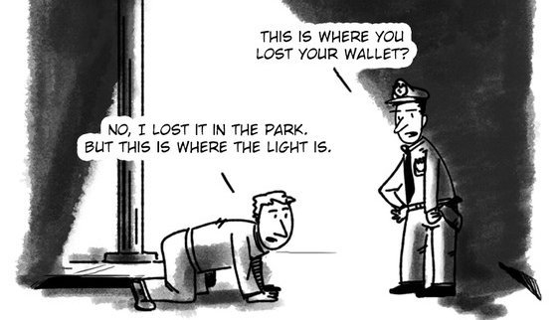
Assessment is about the Content…
Module 9: Ensuring “Do No Harm” – Assessing Vulnerabilities, Needs and Strengths
Assessment is critical to setting up success: an assessment that misses key areas or is stigmatising will lead to lost opportunities for intervention success.
Notes:
Let’s start with understanding what goes into an assessment under this framework. Assessment is critical to setting things up for success.
Assessment is like the parable of the man who has lost his wallet or his keys and is looking for it under the streetlight. When a bystander asks him if this is where he lost it, he says: “No, I lost them in the park – but this is where the light is!”.
We know that he will never find his key if he does not look in the right place, even if it is harder. Assessment is much the same: if you do not take the time and effort to do a thorough assessment, and to set it up so that it emphasises strengths rather than stigmatising, you may miss the key to helping someone.
An intervention plan can only be as good as the assessment on which it is built. A thorough and accurate assessment is necessary to ensure the most critical domains are addressed.

Slide 129
… and the Process
Module 9: Ensuring “Do No Harm” – Assessing Vulnerabilities, Needs and Strength
Notes:
Assessment is about the content – but also the process.
[Refer to the concept of “strategic listening” that was brought up in Module 1, which is true at the level of the individual client, too].
Assessment sets up the relationship between the team and the individual being served, and central to this is the idea of “Do No Harm”. An assessment that stigmatises an individual, or that fails to recognise strengths, can actually undermine the goals of the program.
On the flip side, an assessment that conveys positive regard for the individual and communicates genuine care can lay the foundation for enduring trust and engagement by that individual in the program. Trust, again, is important not just at the programme level, but at the individual client interaction level.

Slide 130
Flow Chart
Module 9: Ensuring “Do No Harm” – Assessing Vulnerabilities, Needs and Strength
Concern / Advice
Referring
Initial Assessment / Screening
Confirmed P/CVE?
Multi-Actor Management Group
Information Sharing and Assessment
Intervention Decision
Monitoring
Disposal
NO
YES
Notes:
You have already seen this schematic of a potential flow chart for case management.
The squares in red we have discussed at length during the previous module, i.e., the purpose of case management, methods of recording, initial assessment and decision making and where appropriate disposal.
The squares in blue will be discussed in this module as we move into a multi-actor framework with detailed assessments as to vulnerability and need of individuals.

Slide 131
Assessment – What do we need to know?
Module 9: Ensuring “Do No Harm” – Assessing Vulnerabilities, Needs and Strengths
‘Assessment’ can mean very different things depending on the discipline. This is especially important to understand in a multi-actor team context.
Notes:
What do we mean by assessment? In many ways, that depends on who is answering. Think about the paper exercise we did during Module 1 – everyone’s paper looked different. This is also true in assessment – what information you have access to, or prioritise, depends on your particular role and relationship to the individual.
[Ask participants the following questions in plenary:
What does assessment mean to you?
What discipline or role do you hold, and what do you think we need to know when we are assessing an individual?].

Slide 132
Assessment in an MDT Context
Module 9: Ensuring “Do No Harm” – Assessing Vulnerabilities, Needs and Strengths
Assessment can mean very different things depending on the discipline
Practical needs and resources?
Risk?
Family perspectives and priorities?
Mental health and psychological factors?
Notes:
“Assessment” can mean very different things depending on the discipline. This is especially important to understand in a multi-actor team context. For example, the security field may emphasise assessment of risk, while psychologists may emphasise the assessment of individual psychological factors, mental health, etc. Social workers may emphasise practical and logistical needs and resources; and community partners may emphasise practical and logistical needs and resources.
Under a multi-actor team assessment, the goal is to conduct an integrated assessment across these areas such that a 360-degree understanding of an individual’s needs, strengths and risks can be developed and addressed. This allows for better engagement, more strategic use of resources, and the opportunity to provide an integrated treatment approach that can leverage the greatest positive change.

Slide 133
Framework for Assessment
Module 9: Ensuring “Do No Harm” – Assessing Vulnerabilities, Needs and Strengths
Taking a comprehensive approach to understanding risks, needs and strengths across the social ecology.
Strengths and needs
Social
Cultural
Relational
Psychological
Practical
Risk
Risk for violent behaviour
Risks to the individual
Barriers to engagement
Practical
Cognitive
Emotional
Notes:
A comprehensive assessment should cover multiple areas across the social ecology as well as at the level of the individual. We have broken them down into three main areas:
Strengths and needs, which includes looking at social, cultural, relational psychological and practical factors;
Risk, which involves both the individual’s risk for violence but also any potential risk to the individual; and
Barriers that might impact their engagement in intervention.

Slide 134
Assessing Strengths and Needs
Module 9: Ensuring “Do No Harm” – Assessing Vulnerabilities, Needs and Strength
Strengths and needs
Social
Cultural
Relational
Psychological
Practical
Social networks (+/-)
Hobbies
Stigma, discrimination, belief systems, ideology, trust in government
Family conflict or support, peers, bullying, triggering events
Mental health, trauma, cognitive flexibility, triggering events, development
Employment, housing, educational needs
Notes:
Let’s start by looking at the different domains of strengths and needs that can inform a comprehensive assessment. Take a look at this slide – is there anything missing? Is there anything there that seems surprising?
[Skip below for programmes that are earlier in their learning of MDT. If more advanced content is warranted, you can keep below content].
Although different programmes emphasise different specific areas for assessment, common across all of them is an emphasis on understanding an individual’s strengths and needs.
Under the social heading, it is critical to get a sense of the individual’s social networks – which may be either a protective resource or a risk or, at times, some of each. Who do they spend time with? Groups, clubs, online or in person? Are these relationships sources of support and belonging, or conflict and polarisation? This is also an opportunity to assess hobbies or interests that may become key sources of strength and protection in the intervention plan, such as an interest in sports or the arts.
Culturally, you want to get a sense of both the individual’s own culture – their ethnic or religious background – as well as how they relate to the larger culture and society in which they are living. Do they express a sense of overall belonging and trust in the larger community, or feel excluded, treated unfairly? Is this a source of resentment? This may also be a time to non-judgmentally seek to understand any motivating ideologies.
Under relational strengths and needs, this is an opportunity to go more in-depth into understanding an individual’s closest relationships, such as family or peers. Are these closest relations supportive of the individual’s care and growth? Is there conflict and tension? Has any of this tension contributed to vulnerabilities, such as being bullied or perhaps leading to a triggering event?
The psychological domain can be very broad, and incorporates aspects related to mental health – such as depression, anxiety, or trauma exposure – but also cognitive flexibility, any potential developmental delays or disruptions, and more broadly psychological outlooks on life such as hopelessness.
And finally, the practical category assesses basic needs such as employment, housing, and education. In many cases, practical issues such as unemployment and housing problems may stand in the way of helping an individual becoming stable and integrated in society. It is also usually one of the easier ways to help a family and can help build a relationship of trust.

Slide 135
Tools for Assessing Strengths and Needs
Module 9: Ensuring “Do No Harm” – Assessing Vulnerabilities, Needs and Strengths
Clinical interview
Supplemental structured instruments
Notes:
So how do you go about getting this information? Two basic approaches, often seen together:
A good clinical interview and case history paired with information gathering from collateral sources is key to developing a comprehensive understanding of strengths and needs. Conducting this kind of interview requires significant training and capacity building. Mental health professionals typically receive training in this area; depending on the background of MDT assessors additional training and support in this area may be helpful. When mental health providers are not available, other community workers may be supported to learn these skills [See additional resource – Murray, L., et al., 2011].
Some programmes may choose to implement more structured instruments in order to have a better understanding of some of the specific areas. For instance, there are a number of trauma screeners available that can help to assess traumatic exposure in a way that is developmentally appropriate [See resource list at end].
[If relevant to the programme being trained] A web-based toolkit developed out of children’s hospital guides assessment of psychosocial stressors that relate to children who are immigrants.

Slide 136
Assessing Risk
Module 9: Ensuring “Do No Harm” – Assessing Vulnerabilities, Needs and Strengths
Goals of Risk Assessment
Ultimate goal: to prevent violence
Interim goals:
Assist decision-making about what can be done (guide action)
Enhance accountability
Protect rights of patients and offenders
Minimise professionals’ exposure to liability by ensuring transparency and consistency
(Hart, S. D. et al., 2017)
Notes:
So far we have talked about assessing strengths and needs. In our assessment framework, the second key area is about assessing risk.
First, I want to think about why we include risk assessment as part of a psychosocial assessment in the first place. You may be thinking: “Well, risk is assessed by law enforcement. That is their job, not part of psychosocial support”. Or you may be thinking: “Risk should be assessed as part of the screening process – by the time they get to me, I should know they are not at risk of doing anything dangerous”.
Yes, true that risk takes place at those different phases and by different people. But it is also an important part of understanding what kinds of support an individual needs, and whether you are able to provide enough support to ensure safety. Risk is also not a static characteristic – it can change. So as someone involved in providing psychosocial assessment and intervention, it is very important to know what to look for, to continually update thinking about risk and to know when the services you have to offer are perhaps not sufficient given the risk level.
What are the goals of risk assessment? Ultimately, to prevent violence, but interim goals include:
Assist decision making about what can be done (guide action).
Enhance accountability.
Protect rights of patients and offenders.
Minimise professionals’ exposure to liability by ensuring transparency and consistency (Hart, S. D., 2017)

Slide 137
Assessing Risk
Module 9: Ensuring “Do No Harm” – Assessing Vulnerabilities, Needs and Strengths
“Linking risk factors to protective factors allow for a positive, action-based approach that highlights social policies and practices of individual care and counselling. This is the foundation for a genuine preventive outlook in which all kind of risks of radicalisation are mitigated”.
(EU RAN, 2018)
Notes:
As it is illustrated by this quote, understanding risk is not separate from the earlier discussion we had about understanding and assessing strengths and needs [Read quote].
A good risk assessment will take into account the social environment that surrounds an individual and the ways, both good and bad, that this interacts to either promote or protect an individual from engaging in violence.
But we also want to make sure that we have a way of specifically assessing risk. How do we do this?

Slide 138
Approaches to Risk Assessment
Module 9: Ensuring “Do No Harm” – Assessing Vulnerabilities, Needs and Strengths
Unstructured / Expert clinical judgment (‘intuition’ or ‘instinct’)
Not much better than chance.
Actuarial or structured checklist: categorises people according to risk or estimates the probability of an outcome by using an established checklist/screener.
More accurate, but does not account for individual variation or transfer easily to new populations/context. Also, it does not clearly indicate treatment targets.
Structured professional judgement
Combines statistically predictive, dynamic factors and clinical evaluation → preferred approach
(RTI International, 2018)
Notes:
Historically, there have been several different approaches to risk assessment, none of which is perfect, but some of which are better than others:
Unstructured clinical judgement – sometimes called intuition or instinct – is problematic as it tends to rely on short cuts to decision making that are based on bias and stereotypes. Chief limitations are lack of transparency, low reliability (not consistent), and low predictive validity (not accurate).
Actuarial risk assessment: this is an empirical approach that categorises people according to risk based on a fixed set of characteristics or factors. If someone scores high on a set of identified factors, they will be considered high risk. Strengths of this approach are high transparency, moderate to high reliability, and moderate predictive validity. However, it relies on a fixed and restricted set of factors, which are not adapted or optimised for different unique populations or settings or contexts.

Slide 139
Approaches to Risk Assessment
Module 9: Ensuring “Do No Harm” – Assessing Vulnerabilities, Needs and Strengths
Structured professional judgement:
“An analytical method used to understand and mitigate the risk for interpersonal violence posed by individual people that is discretionary in essence but relies on evidence-based guidelines to systematise the exercise of discretion”
Strengths: increases the transparency, reliability, and predictive validity of violence risk assessments without sacrificing their individualisation and flexibility.
But … evaluators must have some training and experience, and it still requires good empirical risk indicators.
(Hart, S. D. et al., 2017)
Notes:
An effective approach for overcoming these significant limitations is to use what is called structured professional judgement. An evaluator using structured professional judgement will conduct an interview that is informed by an understanding of risk factors, with additional instruments or checklists to guide collection and analysis of information.
So, structured professional judgement - what does it mean and why do we use it?
It is “an analytical method used to understand and mitigate the risk for interpersonal violence posed by individual people that is discretionary in essence but relies on evidence-based guidelines to systematise the exercise of discretion” (Guy, Douglas and Hart 2015).
It is recognised universally as good assessment practice. It provides guidance to practitioners to structure their judgments of risk based on key indicators that have theoretical or empirical links to violence. It is a holistic assessment that integrates from multiple sources.
It provides some structure and systematisation while at the same time helping to tailor the assessment to unique context and individual.
Strengths of this approach are an increase in the transparency, reliability, and predictive validity of violence risk assessments without sacrificing their individualisation and flexibility. However, evaluators must have some training and experience and it still requires good empirical risk indicators.

Slide 140
Risk Assessment Tools to Aid Structured Professional Judgement
Module 9: Ensuring “Do No Harm” – Assessing Vulnerabilities, Needs and Strengths
Returnee 45
ERG22+
A tool for investigating motivation, commitment and risks posed by returnees
Assesses risk and needs in convicted extremist offenders and others for whom there are credible concerns of VE. Used by Channel in UK. Present-focused snapshot of psychological profile. Independent of specific context and ideology.
TRAP-18
Assesses risk of individuals engaging in lone-actor terrorism to assess threat assessors with prioritising cases for risk management. Used as an investigative framework.
VERA-2
Assesses the likelihood of future violence by an identified offender who has been convicted of ideologically motivated violence. Used in prison and probation services in several countries, formulated based on theory. Includes historical information, focuses on risk for extremist violent acts
IR46
Dutch tool used for multiagency assessments in “safety houses”
Notes:
This slide lists several commonly used instruments that can aid in structured professional judgment, such as the Violent Extremism Risk Assessment (VERA2-R) or the Extremism Risk Guidance (ERG 22+). These have been introduced and used widely in counterterrorism and are making their way into deradicalisation/disengagement and other P/CVE activities as well.

Slide 141
Limitations of Tools
Module 9: Ensuring “Do No Harm” – Assessing Vulnerabilities, Needs and Strengths
Regardless of the tool used, there are common limitations:
Violent extremism is extremely low base rate: most individuals will not engage in extremist violence.
Tools have not been empirically validated.
Variations in cultural and historical context can shape motivations for joining violent extremist groups, and statistical-derived risk factors may not reflect this.
Notes:
Regardless of the tool used, there are common limitations that need to be taken into account:
There is no single indicator or mix of indicators to demonstrate an individual is radicalising to violent extremism. Because violent extremism is very rare, most individuals – regardless of how they score on a screener – will not engage in extremist violence.
The fact that it is so rare also makes it difficult to empirically validate tools.
And finally, risk factors are likely to vary by cultural and historical context so statistically derived risk factors may not transfer easily from one setting to another.
In short, risk assessment is never perfect. Providers will need to do their best with the tools and resources they have, with an overall goal of reducing risk as best they can.

Slide 142
Risk Assessment Tools to Aid Structured Professional Judgement
Module 9: Ensuring “Do No Harm” – Assessing Vulnerabilities, Needs and Strength
Regardless of the instrument…
Rely on context-specific local research and include factors linked to the targeted population
Consult with local professionals and practitioners, including for the purposes of relying on multiple sources of information
Take into account the wider political and social contexts
Account for protective and resilience factors, as well as for extremism related risks
Be informed by and linked to available interventions and support services
(OSCE, 2019)
Notes:
Given this, regardless of instrument, the OSCE suggests to:
Rely on context-specific local research and include factors linked to the targeted population.
Consult with local professionals and practitioners, including for the purposes of relying on multiple sources of information.
Take into account the wider political and social contexts.
Account for protective and resilience factors, as well as for extremism-related risks.
Be informed by and linked to available interventions and support services (OSCE, 2019).
It is also necessary assess external risks to the individual (such as a “returnee”), e.g., ‘mediatisation’, target of retaliation, intimidation, threats, and mitigation strategies.
[Discuss the following questions with participants:
What kind of risk assessments are currently being used in your country/locality and by whom?
What are some of the barriers you see to being able to implement a structured clinical judgement approach?].

Slide 143
Assessing Barriers to Care: Laying the Groundwork for Successful Engagement
Module 9: Ensuring “Do No Harm” – Assessing Vulnerabilities, Needs and Strength
Practical
Language
Transportation
Time/money
Childcare
Cognitive
This won’t work
This isn’t what I care about
This will stigmatise me and my community
Emotional
Distrust
Disillusionment
Anger
Notes:
The final area of assessment in our framework is what we call ‘barriers to care’. In other words, you can have the best programme ever but if the individual does not engage, it does not work. To facilitate engagement, you have to consider practical, cognitive and emotional barriers to care and work to align the services with a family’s goals:
Practical barriers include language, transportation, time, money, childcare. Language is especially true of youth from Da’esh, or immigrant families.
Cognitive barriers: “this won’t work”, “this isn’t what I care about”, “this will lead to stigma in my community”, etc.
Emotional barriers: feelings of distrust, disillusionment, anger, etc.

Slide 144
Assessing Barriers to Care: Laying the Groundwork for Successful Engagement
Module 9: Ensuring “Do No Harm” – Assessing Vulnerabilities, Needs and Strength
Practical
Language
Transportation
Time/money
Childcare
Troubleshoot, build trust through recognising challenges
Cognitive
This won’t work
This isn’t what I care about
This will stigmatise me and my community
Make room to hear and understand, provide hope, ensure confidentiality
Emotional
Distrust
Disillusionment
Anger
Use assessment to build relationship, engage trusted liaison, assume non-judgemental stance
Notes:
Strategies for addressing cognitive barriers can involve making room to hear these, take them seriously, provide hope, ensure confidentiality, take the time to understand what they believe will work, identify past experiences that may be informing these perspectives, etc.
Strategies to overcome emotional barriers can include using the assessment process to build a relationship, taking time to understand families’ perspective, engaging a ‘trusted liaison’ in the assessment process, leaving room for family to express these feelings, or practicing reflective listening and assume a non-judgmental stance.
[Discuss the following questions with participants:
What do you think could be significant barriers in your context?
Do any of these stand out as particular concerns?
How do you think we could overcome those?].

Slide 145
Who Does the Assessment?
Module 9: Ensuring “Do No Harm” – Assessing Vulnerabilities, Needs and Strengths
Concerns and needs of family are…
Don’t forget strengths
I assessed some mental health issues…
Who does the trust?
I’ll assess risk
Go team!
Notes:
Ok, now that we have talked about what we want to learn during the assessment, let’s shift to thinking about who is in a position to get that information.
Well, the short answer is that there is no “one-size-fits-all” approach. Depending on the context, the police could play a role in assessing risk. However, too much police involvement can undermine the trust from non-law enforcement professionals, practitioners, and local community members required for success of the programme.
In most EU countries, the police are responsible for a risk assessment from the security perspective. However, for cases not involved with law enforcement this may ‘securitise’ the case and a mental health or other professional trained in risk assessment may be able to do this instead (EU Radicalisation Awareness Network, 2017).
Family workers will be more involved in mapping the concerns and needs of the family. Most family workers do not have a formal needs assessment tool but work with an intake form. (EU Radicalisation Awareness Network, 2017).
Some teams pair a ‘trusted liaison’ or ‘cultural broker’ with the assessor/s to facilitate engagement and also to help the assessor better understand the role culture may play in client expectations, attitudes and behavior.
[Discuss the following questions with participants:
Who is in a position to gather information as part of a multi-actor team in your context?
Who do you think should be involved in a multi-actor team?].

Slide 146
Sources of Information
Module 9: Ensuring “Do No Harm” – Assessing Vulnerabilities, Needs and Strengths
Different sources of information can provide different pieces to the puzzle.
Notes:
The assessment may be done by one individual with appropriate expertise, but sometimes different aspects can be done by different people and brought together. Any such assessment process should be informed by multiple sources, including interviews with the individual, family members, peers, and teachers; social network observations; and the case files of social, youth, and mental health workers and other relevant professionals.
Regardless of who does the assessment, it is key to leverage the assessment process to build relationships/trust. And, as discussed in the earlier module, developing appropriate information-sharing protocols is critical to ensuring that all the different pieces of the puzzle can be put together (OSCE, 2019).

Slide 147
Key Principles of Assessment
Module 9: Ensuring “Do No Harm” – Assessing Vulnerabilities, Needs and Strengths
Take a strengths-based approach.
Use the assessment to build trust and relationship.
Learn what matters to the individual/family.
“Do No Harm”
Notes:
Regardless of whether or not tools are used to support the information gathering of strengths and needs, keep in mind the basic principles of:
Assessing strengths and protective factors.
Using the assessment as an opportunity to build a trusting relationship.
Learn what the individual or family’s priorities are.
Avoid stigmatising, retraumatising or, in other ways, risking the individuals’ wellbeing through the assessment process.

Slide 148
Breakout Exercise
Module 9: Ensuring “Do No Harm” – Assessing Vulnerabilities, Needs and Strengths
Instructions
Read through a case example.
Discuss and answer the following questions:
What areas of information are relevant to an assessment? What additional information would you like to get?
What sources might you go to in order to obtain this additional information?
Notes:
[Break participants into their preassigned groups and ask each team to read through a case example. Use the prompts on the slide as discussion points.
Give each group 15 (if online) or 20 minutes (if in-person) to discuss, and then ask each group to share in plenary their approach including thoughts on the above discussion points].

Slide 150
Module 10
Ensuring “Do No Harm” – Developing and Implementing Tailor-Made Individual Support Plans

Slide 151
Goal
Module 10: Ensuring “Do No Harm” – Developing and Implementing Tailor-made Individual Support Plans
To provide a framework and specific guidance for interventions within a multi-actor framework and ensuring a “Do No Harm” approach.

Slide 152
Learning Objectives
Module 10: Ensuring “Do No Harm” – Developing and Implementing Tailor-made Individual Support Plans
Identify the key domains and potential tools/approaches for intervention under a multi-actor approach.
Understand that available interventions must align with vulnerabilities and strengthen the protective factors identified during assessment.
Describe special considerations by age and gender.
Understand the potential harm that could come from interventions and the need to adopt reduction/avoidance strategies.

Slide 153
Module Overview
Module 10: Ensuring “Do No Harm” – Developing and Implementing Tailor-made Individual Support Plans
Theoretical background
Intervention
Special considerations by age and gender
“Do No Harm” considerations
Notes:
In this module, we will briefly cover the theoretical background from which we are working, and then move practically to how to carry out interventions in a multi-actor team while taking into account “Do No Harm” considerations and other special considerations by age and gender.

Slide 154
Intervention
Module 10: Ensuring “Do No Harm” – Developing and Implementing Tailor-made Individual Support Plans
Assessment
Intervention
Meaningful change
Notes:
Once a thorough assessment has been conducted, the next step is to translate our new understanding of the individuals’ strengths, needs, and risks into an effective intervention plan.
This is where it all comes together in meaningful change for an individual and, ultimately, society.

Slide 155
A ‘Whole of Society’ Model
Module 10: Ensuring “Do No Harm” – Developing and Implementing Tailor-made Individual Support Plans
Culture, nation
Community, neighbourhood
Family, peers, school or job
Individual
(Urie, B., 1979)
Notes:
Interventions may take place at any, or multiple, levels of the social ecology. The particular constellation of interventions will be tailored to the individual’s strengths and needs and will not necessarily look the same from one person to the next.

Slide 156
Key Principles of Intervention
Module 10: Ensuring “Do No Harm” – Developing and Implementing Tailor-made Individual Support Plans
Interventions should address something that matters to individuals/families
Interventions should be supportive, facilitate dignity and avoid stigma.
Intervention packages should be mindful of ‘unintended consequences’.
Notes:
Common principles should underpin all plans, however:
Engaging individuals and families in interventions that they perceive as valuable to their goals. An intervention plan that is solely focused on the agenda of law enforcement/other security actors or outside professionals is unlikely to be effective.
Interventions should be supportive, facilitate dignity, and avoid stigma.
Intervention packages should be mindful of ‘unintended consequences’, e.g., stigma, over-intervention, community resentment or backlash, or securitisation and stigmatisation of social and supportive services.

Slide 157
Addressing Strengths and Needs
Module 10: Ensuring “Do No Harm” – Developing and Implementing Tailor-made Individual Support Plans
Strengths and needs
Social
Cultural
Relational
Psychological
Practical
Notes:
Recall that in the assessment slides we talked about there were five main areas of strengths and needs that should be assessed. These are: social, cultural, relational, psychological, and practical. The task of the team following the assessment should be to translate these assessments into intervention. There is no single approach to intervention that will work for everyone. Instead, team members should work together to identify an intervention or suite of interventions that they believe will most meaningfully address the needs of the individual, build on their strengths, and create conditions in which risk is ultimately diminished. The intervention approach may also shift over time as new needs emerge, or as an individual progresses through treatment. Regular discussion of cases among team members can help facilitate this continued tailoring of the plan.
The interventions offered should also be specific to your local context and resources; we will review types of interventions that may be helpful in addressing the various strengths and needs, but ultimately the package for each individual should be tailored according to their needs and strengths, as well as the community’s resources.

Slide 158
Addressing Strengths and Needs
Module 10: Ensuring “Do No Harm” – Developing and Implementing Tailor-made Individual Support Plans
Social
Arts
Civic engagement and non-violent activism
Sports
Hobbies
Notes:
Let’s walk through each of these intervention areas and brainstorm a bit about the kind of activities that could play a role in addressing strengths and needs. Across all of these areas, a lot is going to depend on what is available in your particular community – what resources are already out there, and how could they be matched to the strengths and needs of an individual to help.
Let’s start with social interventions. Essentially, this is about what activities can help to build healthy relationships. These may involve connecting an individual with opportunities to pursue their hobbies or interests in the context of a positive social group, such as arts or civic engagement. In particular, sports teams can play an important role here, offering a sense of bonding and purpose as part of a team.
Social activities can offer constructive channels for voicing grievance and seeking to make change, support strong relationships, and help individuals to identify goals and have support in reaching them. These activities can be critical to leveraging strengths and building positive social connections.
[Discuss the following questions with participants:
What else might be here?
What would be most relevant in your community/context?].

Slide 159
Addressing Strengths and Needs
Module 10: Ensuring “Do No Harm” – Developing and Implementing Tailor-made Individual Support Plans
Cultural / ideological
Provide mentorship
Exposure to new ideas
Education / learning
Build relationship
Notes:
Let’s think for a minute about cultural/ideological interventions. One central question around working with individuals at risk of radicalisation to violence has to do with whether or not to address ideology or religion.
Should ideology be addressed as part of the intervention? Most multi-actor teams take the approach that this is not the place to focus. Generally, practitioners believe that confronting an individual about their ideology should be avoided as this can contribute to breaking the treatment alliance and further entrenching an individual’s beliefs. Rather, it may be helpful to take the approach of ‘introducing complexity’ into thinking or offering alternative ways of thinking or expanding thinking. This may be done by, or in close partnership with, a faith-based mentor who can provide religious mentorship or instruction, introducing complexity into thinking, expose the individual to other ideas, but not push back. Most centrally, a strong relationship will be the most effective tool for helping an individual move away from a violent ideology.

Slide 160
Addressing Strengths and Needs
Module 10: Ensuring “Do No Harm” – Developing and Implementing Tailor-made Individual Support Plans
Relational
Family therapy
Bullying prevention at schools
Community stigma reduction
Address family conflict
Parent-child communication
Notes:
Relational interventions specifically focus on addressing relational conflicts that may be creating challenges for an individual, or that could be strengthened as an important source of support during this time. If you think about social relationships as being about positive relationships, this category is really about reducing negative or conflictual relationships.
Interventions here might include family therapy to address conflict at home (Koehler, 2016) or may be systemic. for instance, if a youth is experiencing bullying at school the most effective intervention may be to work with the school around how to prevent bullying and foster a more inclusive school community. It may also involve work at a community level to help diminish stigma.

Slide 161
Addressing Strengths and Needs
Module 10: Ensuring “Do No Harm” – Developing and Implementing Tailor-made Individual Support Plans
Psychological
Mental health care
Support for well-being
Encouraging cognitive flexibility
Evidence-based approaches
Trauma informed care
Developmental support
Developmental disorders e.g., autism spectrum
Attachment
Positive identity development
Supporting sense of purpose
Notes:
Psychological interventions can include mental health treatment, support for general well-being, encouraging cognitive flexibility, and developmental support.
Working with a trained mental health professional is often one of the most important aspects of an intervention package. This can be in response to a specific diagnosis, such as depression or anxiety, but may also be used to help bolster an individual’s sense of well-being, enhance cognitive flexibility, or—especially with children—address developmental needs such as autism.
One aspect of mental health that may be particularly important to address is trauma and trauma related symptoms [At the end of this module, there are links to websites that provide more information on evidence-based approaches to trauma-informed care].
[Discuss the following questions with participants]. Let me pause for a minute here and hear from you about the past few areas of intervention we have talked about – cultural or ideological support or mentorship, conflict reduction, and mental health or psychological interventions:
How do you see these working in your context?
What might be drawn on to help with these areas?
[Optional additional content] The type of mental health care provided will be driven by the assessment that was done, and the individualised needs that were identified through that assessment.
[Optional additional content] Important to note that in some contexts there will be cultural sensitivities and stigmas surrounding mental health care that will require navigation and mitigation. In addition, in some contexts there will be a lack of mental health professionals, let alone properly trained ones. In such cases, community-oriented arts- and drama-based approaches to psychosocial care could be considered in lieu of professional mental health treatment.

Slide 162
Addressing Strengths and Needs
Module 10: Ensuring “Do No Harm” – Developing and Implementing Tailor-made Individual Support Plans
Practical
Housing
Employment
Education
Notes:
And, finally, there are practical needs. This may involve connecting an individual with resources or benefits to address housing requirements, employment training, or educational needs. These interventions, which can leverage existing loc can both reduce barriers to healing and also serve to build trust that allows for other interventions to occur.
One key point here is that, sometimes, practical help is the most critical way to build trust. Someone may be willing to take help around a concrete need – and once this helping relationship is established, trust evolves, and other types of support may be accepted too.
Importantly, these type of concrete needs can also be central to engagement. An individual may readily accept practical support around getting a job long before they are willing to engage in mental health services, and the relationship forged around addressing those needs can then later form the bridge other types of services.

Slide 163
Putting It Together
Module 10: Ensuring “Do No Harm” – Developing and Implementing Tailor-made Individual Support Plans
Consider engagement – what is a priority for the individual/family? What will motivate their engagement?
Beware of too many interventions.
Intensity of intervention needs to match risk level.
Notes:
Once the full assessment has been reviewed, and potential interventions identified to map onto the identified needs and strengths, the team must put together an intervention package. This may be as simple as a single intervention, such as connection with a mental health provider, or may involve multiple providers and interventions who work together to provide a suite of services for the individual. Regardless, a few key principles underlie this step:
Consider engagement – what is a priority for the individual/family? What will motivate their engagement? No intervention will work if the individual is not motivated to engage in it.
Beware of too many interventions. This can undermine the work by overwhelming an individual and threatening engagement, or by fostering resentment within a community that might perceive that individual as receiving unfair benefits.
Intensity of intervention needs to match risk level – the higher the risk, the more critical it is that interventions are intense enough that risk can be both mitigated and monitored.

Slide 164
The Whole Is More Than the Sum of the Parts
Module 10: Ensuring “Do No Harm” – Developing and Implementing Tailor-made Individual Support Plans
Integrating different aspects of intervention can strengthen each contribution.
Notes:
Ultimately, each piece of the intervention package should work to reinforce the others so that the overall package is more than the sum of its parts. For example, if a religious leader is providing exposure to new ideas, perhaps a therapeutic intervention is helping the individual address anxiety that might be interfering with the client’s comfort in trying something new. If a therapist is working on behavioural activation to address depression, perhaps the sports club is providing extra outreach to make sure the individual shows up at practice.

Slide 165
Coordination Is Key
Module 10: Ensuring “Do No Harm” – Developing and Implementing Tailor-made Individual Support Plans
Conflict with her parents is diminishing
Let’s ask the family therapist
Behavioural activation is helping with depression
She’s made every soccer practice
What about online activity?
Go team!
Notes:
Through streamlined communication and coordination – which takes place through the team – each intervention can be maximised and magnified so that ultimately the whole package is effective.
Consider the team’s role in facilitating communication/coordination and supporting providers with learning and perspectives from other disciplines.
Clinical case management and coordination can be an essential component to ensure that services work together.

Slide 166
Who Provides the Intervention?
Module 10: Ensuring “Do No Harm” – Developing and Implementing Tailor-made Individual Support Plans
Intervention can involve one to many players
Social, health or youth worker
Mentor, coach, religious counselor
“ Former ”
Mental health provider
Trusted liaison / community worker
Drug and alcohol counsellor
Police, probation officers
Notes:
Who provides the intervention will depend on which interventions are identified for the individual.
Ideally, the team includes members who can provide some of the identified services/support, or who is connected via a network to relevant services providers. Networks of providers in the community can also be identified and, over time, the MDT can help to build their capacity to work with referred individuals.
Typical providers might include social workers, youth works, mental health providers, police or probation officers, community advocates, drug and alcohol counsellors, or ‘formers’.
Ideological experts may play an important role as well: whether it is an imam or a former right-wing extremist, it can be useful to involve someone who can talk to the family and the individual about the ideological dimension. They might ask questions such as: “where do their ideas come from?”, “what are the sources and why are they reliable or not?”, “what are alternative perspectives?”, etc. (EU Radicalisation Awareness Network, 2017)
Finally, a case manager will be critical to ensuring that the interventions are well coordinated.
[Discuss the following question with participants: Who do you see being able to deliver services as part of a multi-actor team?].

Slide 167
Assessment and Intervention Considerations by Age
Module 10: Ensuring “Do No Harm” – Developing and Implementing Tailor-made Individual Support Plans
Assessment and intervention need to be appropriate to developmental level:
Reasoning and cognitive abilities still developing
Collateral sources critical to gaining full picture
Assessment needs to be mindful of avoiding re-traumatisation, trust-building and creating a sense of safety
Address current safety and potential child protection issues
Assessment and intervention should address age-specific areas:
Schools
Developmental lags
Bullying
Child trauma
Notes:
Assessment and intervention should be tailored to an individual’s developmental stage and gender. Let’s start with considerations around children.
As noted by the Global Counterterrorism Forum (GCTF), “children’s reasoning and cognitive abilities are still developing and consideration should be given to both their vulnerabilities as well as to their particular capacities, which differ from those of adults” (Global Counterterrorism Forum, 2016).
Assessment needs to be mindful of avoiding re-traumatisation, trust-building, and creating a sense of safety. As part of this, it will be important to assess current safety of the child, and potential child protection issues. Child specific areas that should be included in assessment and intervention include school issues, developmental lags, and social concerns such as bullying or childhood trauma.
Because children, especially young children, may not always be able to provide a full understanding of their circumstances, it is important to gather information from, and work with, a variety of collateral sources. Especially with younger children, intervention will need to engage individuals and systems that work with the child such as parents and schools.

Slide 168
Ensuring an Age Sensitive Approach
Module 10: Ensuring “Do No Harm” – Developing and Implementing Tailor-made Individual Support Plans
An age-sensitive approach might involve:
Involve child serving systems, such as schools or child protection.
Gather information from parents and other sources; interventions are sometimes most effective with parents or other adults, not just the child.
Focus on helping the child achieve the milestones right for their age – success in school or being part of a sports team may be the most important factors for long term adjustment and success.
Involve child specialists as needed to understand developmental needs and to facilitate engagement and communication.

Slide 169
Assessment and Intervention Considerations by Gender
Module 10: Ensuring “Do No Harm” – Developing and Implementing Tailor-made Individual Support Plans
Process considerations: consider preference for meeting with same gender provider
Consider how social norms and societal expectations shape gender forms
(GCTF, 2015)
Assess for gender-based violence/sexual trauma exposure
Consider how gender roles, lack of access, lack of information may have created push factors or contributed to vulnerabilities
(Choudhury Fink, N., and Bulai, R., 2016)
Notes:
Gender should also be considered in the course of assessment and intervention.
Gender may influence both how the assessment or intervention is conducted – such a pairing a female provider with a client if that is important – as well as what the assessment and intervention plan include. An assessment may include understanding how social norms and societal expectations shape gender norms, the potential for a client to have experienced gender-based or sexual trauma, and also how gender roles, lack of access or information, may have created push factors that contributed to vulnerabilities.
If some of these factors played an important role in the violent radicalisation process they may need to be considered and addressed as part of the intervention.
Finally, it is also critical to considering trauma, and – for both men and women –the potential impact of sexual or other gender-based traumas.

Slide 170
Ensuring a Gender-Sensitive Approach
Module 10: Ensuring “Do No Harm” – Developing and Implementing Tailor-made Individual Support Plans
Integrating a gender perspective might involve (see, e.g., GCTF / OSCE):
Considering gender of providers.
Understanding gender dynamics of radicalisation to violence.
Consider gender roles in society, how the individual relates to these, and whether these provide sources of strength or stress in their lives.
Notes:
How do you address these age or gender specifics in intervention?
[Discuss the following questions with participants:
How do you see gender playing a role in your context/community?
How should this king of intervention address it?
What about age?].
Integrating a gender perspective might involve:
Ensuring the appropriate gender balance among the professionals and practitioners involved in conducting assessments and designing/delivering interventions.
Understanding the gender dynamics of radicalisation to violence, including the differences between girls/women and boys/men and the need to counteract stereotypes around gender, such as the link between hypermasculinity and violence.
Using gender-specific factors to help determine who is at risk of or vulnerable to violent extremism and developing gender-sensitive interventions to address them.
Being sensitive to cultural settings such as girls or young women not wanting to be left alone with a male professional.
Involving and engaging mothers and fathers, including through awareness raising and other training, on how to identify and address radicalisation (OSCE, 2019).

Slide 171
Do No Harm
Module 10: Ensuring “Do No Harm” – Developing and Implementing Tailor-made Individual Support Plans
The danger of unintended consequences:
Stigma
Pathologising social dissent/resistance, mental illness
(Rousseau, C., et al., 2021)
Over-intervention/community resentment
Securitisation of social services
Notes:
Throughout the assessment and intervention process it is critical to bear in mind the “Do No Harm” principle.
Intervention packages should be mindful of ‘unintended consequences’, e.g., stigma, over-intervention, community resentment or backlash, or securitisation and related stigmatisation of social services.
[Discuss the following questions with participants, if time allows:
What do you see as potential unintended consequences that we need to be thinking about?
What are the risks that could come from this kind of multi-actor assessment and intervention approach?].

Slide 172
Breakout Exercise
Module 10: Ensuring “Do No Harm” – Developing and Implementing Tailor-made Individual Support Plans
Instructions
Read through a case example.
Come up with a proposed intervention plan based on these discussion points:
What type of interventions might you recommend?
Who might provide these interventions?
What strategies could you use to engage the individual?
What are some strengths, either of the individual or in his/her social ecology, that could be emphasised to help with the treatment?
Are there any specific gender, age, or other individual context factors that need to be taken into consideration as the intervention plan is built?
Notes:
[Break participants into their preassigned groups and ask each team to read through a case example. Use the prompts on the slide as discussion points.
Give each group 15 (if online) or 20 minutes (if in-person) to discuss, and then ask each group to share their approach including thoughts on the above discussion points].

Slide 173
Summary and Conclusions
Module 10: Ensuring “Do No Harm” – Developing and Implementing Tailor-made Individual Support Plans
Tailored to the individual’s needs and strengths.
Mindful of “Do No Harm” principles
Built on trusting relationships and respect for the individual
The results of a collaborative, multidisciplinary effort
Notes:
Interventions are where the hard work of building the team and streamlining its operations come together – this is where the thoughtful groundwork of stakeholder involvement, trust, careful assessment, and ethical rigor comes together to make a differences in the lives of individuals and society through preventing violent extremism.
Interventions are:
tailored to the individual’s needs and strengths;
mindful of “Do No Harm” principles;
built on trusting relationships and respect for the individual; and
the result of a collaborative, multi-actor effort.

Slide 175
Module 11
Monitoring and Evaluating (M&E) a Multi-Actor P/CVE Intervention Programme

Slide 176
Introduction
Module 11: Monitoring and Evaluating (M&E) a Multi-Actor P/CVE Intervention Programme
What is monitoring and evaluation (M&E)?
Why is M&E important for P/CVE?
How to implement M&E for P/CVE?
What are the applications of M&E for learning, efficiency, and resource mobilisation?
Notes:
[Before beginning the module, the facilitator should ask participants if they have any prior knowledge in this area and, if so, take five minutes so that one or two participants can briefly explain in what context they have acquired this experience].
The objective of this module is to introduce participants to monitoring and evaluation in the context of multi-actor P/CVE programmes. To do that, we will be addressing four key questions:
How do we define “M&E”;
Why it is important to plan for and include M&E in any P/CVE program;
What are the key steps in implementing M&E; and
What is the added-value of M&E in improving programmes and securing support for them from potential funders.
Like many other subjects addressed as part of this course, M&E is a rich area that could, in and of itself, be the subject of a week-long course. However, since this is a [one-hour (if online) two-hour module (if in-person)], we will be focusing on the foundational elements of M&E, so that participants can acquire the tools needed to consider how it can be applied in their context and how to further learn about it.
This module thus does not aim to be exhaustive, but rather a practical synthesis of key M&E concepts and tools.

Slide 177
Goal
Module 11: Monitoring and Evaluating (M&E) a Multi-Actor P/CVE Intervention Programme
Understand the key concepts and methods of M&E and how to apply them in the context of a multi-actor programme.

Slide 178
Learning Objectives
Module 11: Monitoring and Evaluating (M&E) a Multi-Actor P/CVE Intervention Programme
Understand monitoring and evaluation (M&E) as a tool for strengthening an intervention and its impact.
Identify indicators and plan M&E for the intervention.
Leverage data for adaptation, efficiency, and resource mobilisation.
Notes:
Because running a multi-actor P/CVE programme is complex, M&E is a critical tool to ensure it is running smoothly and achieving its intended objectives. It can help keep track of how different actors are engaging in the program, help understand what difficulties they may be facing, and learn lessons about how coordination between them can be improved. This is what we will be referring to when discussing “process” M&E – essentially, learning about how the multi-actor process is unfolding.
But M&E can also be applied to assess whether the programme is achieving its objectives or whether it is having unforeseen, unintended consequences in the community. This is particularly important with regard not only to efficiency, but also to ensure that P/CVE programmes are run in a way that is consistent with a “Do No Harm” approach. When referring to “intervention M&E”, we will thus be looking at how we can evaluate programme impact and consequences.
Because M&E is about describing and measuring both the process and the impact of the programme, we will discuss how this measurement can be done using “indicators”. We will be defining what an indicator is and how these can be identified in the planning stages of the programme, by looking both at the objectives if the programme as well as the “theory of change” it is using.
Finally, we will discuss how the data that is collected through M&E can be used to improve its processes and impact, but also as evidence that it is working. This is particularly important when reporting back to decision-makers and funders who want to know about programme results. This can help secure political support for the programme as well as additional resources to improve and expand it.

Slide 179
M&E Definition and Purposes
Module 11: Monitoring and Evaluating (M&E) a Multi-Actor P/CVE Intervention Programme
Definitions:
Monitoring: refers to “the task of ensuring that activities are completed on time and within a prescribed budget and plan. It is the assessment of progress toward project implementation – the completion of key activities for intended beneficiaries, implementers, and partners – and the measurement of quantitative outputs such as the number of participants engaged in the activities”.
(Holmer, G., et al, 2018)
Notes:
In general, “M&E” refers to the use of specific tools and methodologies to collect, analyse, and assess data throughout a project cycle or programme in order to measure progress, outcomes, and impact.
More specifically, “M&E” refers to the “task of ensuring that activities are completed on time and within a prescribed budget and plan. It is the assessment of progress toward project implementation – the completion of key activities for intended beneficiaries, implementers and partners – and the measure of quantitative outputs such as the number of participants engaged in the activities” (Holmer, G., et al, 2018).

Slide 180
M&E Definition and Purposes
Module 11: Monitoring and Evaluating (M&E) a Multi-Actor P/CVE Intervention Programme
Definitions:
Evaluation: refers to “the assessment of whether project activities collectively achieved the objectives as intended or planned, and as articulated in a theory of change. Inherent to any effective evaluation effort is a clear understanding of the project objectives, the development of measurable and specific indicators, and access to reliable and relevant data”.
(Holmer, G., et al, 2018)
Notes:
Finally, evaluation refers to “the assessment of whether project activities have collectively achieved the objectives as intended or planned, and as articulated in a theory of change. Inherent to any effective evaluation effort is a clear understanding of the project objectives, the development of measurable and specific indicators, and access to reliable and relevant data” (Holmer, G., et al, 2018).

Slide 181
M&E Definition and Purposes
Module 11: Monitoring and Evaluating (M&E) a Multi-Actor P/CVE Intervention Programme
Purposes:
Demonstrate impact and effectiveness of the programme.
Justify allocation of resources to programmes.
Learning and adapting, improving knowledge, and mobilising resources.

Slide 182
Process Monitoring and Evaluation
Module 11: Monitoring and Evaluating (M&E) a Multi-Actor P/CVE Intervention Programme
What is process monitoring and evaluation?
What happened and why?
Have performance standards been achieved?
Has the intervention/programme been implemented as planned?
Notes:
Practically speaking, what does “process monitoring and evaluation” actually mean in the context of a multi-actor PCVE programme? As we will see, this can vary from programme to programme. Essentially, when we refer to “process”, the word encapsulates all the actions and activities that have been planned for in the programme and that need to be completed in order to achieve programme objectives.
To illustrate what we mean, let’s use a practical example. In Brussels, they recently completed a process evaluation of their multi-agency platform for P/CVE planning and interventions. In order to perform this evaluation, they first examined a series of documents describing the platform itself – what are its objectives and mandate, which agencies are part of it, what is the attribution of roles between them, when and how do they meet, what are the rules governing collaboration and information exchange between them, etc.
Why do you think they did that? [Question to the audience]. Because this information lays down the “processes” of their platform. They describe the objectives of the platform as well as the actions and activities needed to realise them. From that first round of data collection, they could derive the indicators for measuring the platform’s performance. They then conducted interviews with all stakeholders, asking them about their experience within the platform. Finally, they compared the interview results with the indicators they had selected (analysis and evaluation).

Slide 183
Facilitated Discussion
Module 11: Monitoring and Evaluating (M&E) a Multi-Actor P/CVE Intervention Programme
Instructions
Discuss the following questions:
In a multi-actor framework, what processes should be monitored and evaluated for performance?
What criteria should be used to measure performance?
How to collect the data?
Notes:
[Split participants into their preassigned groups. Each group is asked to consider the three questions on the slide. After 10 (if online) or 15 minutes (if in person), participants will reconvene in plenary to discuss their findings].

Slide 184
Process Monitoring and Evaluation
Module 11: Monitoring and Evaluating (M&E) a Multi-Actor P/CVE Intervention Programme
Key take-aways:
Identify processes essential to multi-actor collaboration (e.g., information exchange, trust-building, decision-making, division of roles and leadership, etc.).
Establish criteria to measure effectiveness of process.
Collect data according to the set of criteria (e.g., through regular reporting, questionnaires, interviews, etc.)
Analysis: describe what is happening, how, and why and compare to criteria for effectiveness.
Draw conclusions and formulate recommendations to improve process effectiveness.
Notes:
A critical dimension of and a condition for a successful multi-actor P/CVE programme is trust. While it is rarely explicitly named as a programme objective, in real life it is an essential condition for the realisation of many of the actions and activities upon which the success of PCVE programmes depends. When monitoring and evaluating programme processes, it is thus always relevant and useful to consider the particular objectives and processes that contribute to build trust, as well as those actions and activities that cannot be implemented without trust. Measuring these aspects of the programme will enable you to gain a better understanding of the level of trust achieved and whether it needs to be improved.
It is almost inevitable that complex and innovative programmes involving multiple actors will initially encounter difficulties on different levels. However, that should not deter you from performing M&E and communicating about the results. The purpose of process M&E is not merely to validate an approach but to learn key lessons about how it can be improved. Increasingly, this is seen by decision-makers and funders as evidence that the actors implementing the programme are transparent and trust-worthy.

Slide 185
Impact Monitoring and Evaluation
Module 11: Monitoring and Evaluating (M&E) a Multi-Actor P/CVE Intervention Programme
What is impact monitoring and evaluation?
Focused on impact/effects of the programme
Did the programme/intervention have the intended effect?
What other impact can be observed (positive and negative)?
Notes:
Monitoring and evaluating impact is critical to demonstrate the effectiveness of a particular programme as well as to ensure it does not have harmful, unintended consequences in the community.
The foundational blocks of impact M&E are the programme objectives and the theory of change it uses. It is from these that can be derived impact indicators. When defining the programme’s objectives and theory of change, it is therefore important to consider in advance how “measurable” they will be, and how they can be translated into Specific Measurable Assignable Realistic Time-bound (S.M.A.R.T) indicators. This will make M&E much easier to implement and help ensure it is integrated as part of the programme from the start.
Importantly, when studying the impact of a programme, it is necessary to consider and distinguish two types of measures: quantitative and qualitative. A quantitative measurement, for example, can be the number of interventions conducted within a given community over a year. A qualitative measurement, in this example, could be to evaluate how the interventions were perceived by the recipients and the stakeholders involved.

Slide 186
Facilitated Discussion
Module 11: Monitoring and Evaluating (M&E) a Multi-Actor P/CVE Intervention Programme
Instructions
Discuss the following questions:
What effects should be monitored and measured?
How could effects be measured?
How to collect relevant data?
Notes:
[Split participants into their preassigned groups again. Each group is asked to consider the three questions on the slide. After 10 (if online) or 15 minutes (if in person), participants will reconvene in plenary to discuss their findings].

Slide 187
Impact Monitoring and Evaluation
Module 11: Monitoring and Evaluating (M&E) a Multi-Actor P/CVE Intervention Programme
Key take-aways:
Defining “impact”: what is the programme’s intended outcomes?
Consider impact level to be studied: micro, meso, macro.
Unpack programme goals into measurable indicators.
Has the programme had unintended effects (positive or negative)?
Notes:
As we have seen, ensuring that you are able to monitor and evaluate your programme’s impact starts at the programme planning stage, by unpacking its objectives and theory of change and translating them into S.M.A.R.T indicators as well as identifying data collection methods.
When doing this exercise, it is useful to consider the various levels at which a programme intends to have an impact: the micro/individual level, the meso/community level, as well as the macro/regional or national level.
Because a key ethical dimension of P/CVE is the “Do No Harm” approach, it is essential to think about the unintended effects the programme could have and to formulate ways in which negative impact can be captured and evaluated. Generally, this tends to be a more qualitative dimension of M&E and should therefore use qualitative methods such as semi-structured interviews with community members and intervention recipients to be monitored and evaluated.

Slide 188
Planning Monitoring and Evaluation
Module 11: Monitoring and Evaluating (M&E) a Multi-Actor P/CVE Intervention Programme
Defining objectives: the key questions
What is the programme trying to achieve?
Change in attitude or perception?
Increase or reduction in a particular activity?
Altered pattern of behaviour?
Use programme goals and initial theory of change to identify M&E objectives.
Formulating the right research question is the basis to identify suitable indicators.
Notes:
We will now be looking in more details at how programme objectives can be translated into measurable indicators. This is a critical phase in M&E planning, as it provides the blueprint of what data should be collected and how.
“Unpacking” the programme objectives and theory of change is about understanding and defining in a more specific and measurable way what it is trying to achieve. For example, a programme objective might say “conduct 50 successful interventions”. But how do we define “success”? Are we trying to achieve a change in attitude or perception in the recipient? An increase or reduction in a particular activity? A change in behaviour?
Thus, unpacking “success” involves identifying and describing as precisely as possible the effect that the intervention is aiming to achieve. In many cases, this will result in establishing a list of indicators that, when considered together, can provide a qualitative image of how the intervention has impacted the recipient and how close the result of the intervention is to the “end-state” described in the programme’s theory of change.

Slide 189
Planning Monitoring and Evaluation
Module 11: Monitoring and Evaluating (M&E) a Multi-Actor P/CVE Intervention Programme
Selecting indicators for M&E – key components:
Indicators = measurable variable of something that cannot be directly measured.
Role of performance indicators is to measure effectiveness, identify which factors contributed or not to programme effectiveness and establish casual links between output and outcomes.
Main categories of indicators: background information (national statistics), structural indicators (organisational capacity), process indicators (output), performance indicators (outcomes).
Combine different indicators to establish baseline and measure programme impact.
Use a S.M.A.R.T. approach when thinking about indicators.
Notes:
When defining indicators, it is important to consider whether the proposed indicator is specific enough to the issue at hand that it can be used to establish a causal link between the programme activity and its intended result. One should therefore always “test” proposed indicators against causal logic: does the indicator provide a direct, causal link between programme action and result on its own, or is it necessary to combine several indicators to do so?
Because multi-actor PCVE programmes generally aim to achieve results on several levels (national, community and individual levels), it is necessary to clearly delineate the desired impacts at those different levels and ask whether it is possible to measure them in a reliable way.
In order to have a better view of the possibilities at hand, it is useful to explore the various kinds of indicators that are routinely used in M&E, to measure different kinds of impact at different levels. An overview of these types of indicators is available in the resource links and literature provided as part of this module.
A basic but effective tool to screen indicators and test their validity is the S.M.A.R.T. approach: is the indicator Specific, Measurable, Assignable, Realistic and Time-Bound?

Slide 190
Facilitated Discussion
Module 11: Monitoring and Evaluating (M&E) a Multi-Actor P/CVE Intervention Programme
The “Together” programme seeks to create a multi-actor P/CVE framework involving a local community vulnerable to VE recruitment.
The programme goals are:
effective multi-actor collaboration on P/CVE interventions;
buy-in and collaboration from local community;
reduction in number of youths enrolled in violent extremism groups;
increased sense of security within local community.
Instructions
Discuss in groups the following questions:
What effects should be monitored and measured?
How could effects be measured?
Notes:
[Split participants into their preassigned groups once again. In this exercise, each group is asked to consider the fictional “Together” programme, that seeks to create a multi-actor P/CVE framework involving a local community vulnerable to violent extremism recruitment.
The “Together” programme has four main objectives. Each group will be assigned one of these objectives and asked to consider how that objective can be monitored and evaluated both in terms of process and impact. Remind participants to carefully consider how the objective is described and to try to “unpack” it in a more specific and measurable way.
The goal for each group is to come up with a list of process and impact indicators for their objective that are Specific, Measurable, Assignable, Realistic and Time-Bound.
After 15 (if online) or 25 minutes (if in person), participants will reconvene in plenary to discuss their findings].

Slide 191
Applications of M&E Data
Module 11: Monitoring and Evaluating (M&E) a Multi-Actor P/CVE Intervention Programme
Using M&E data for adaptation, effectiveness and resource mobilisation:
Reflexivity: monitoring data enables course correction.
Good practices: process data enables process improvement and model-building.
Value for money: impact data enables to identify what works and what doesn’t work.
Notes:
As we have seen in this module, M&E is a critical function of project management, particularly in the context of P/CVE. It enables programme managers not only to check that the project is unfolding as planned, but to detect problems and unintended consequences. It is therefore a dynamic tool that offers the opportunity to “course correct” and gradually improve both process and impact.
When implemented consistently over time, M&E also enables programme managers and authorities to develop more reliable and potentially replicable models of how P/CVE should be conducted in their context.
M&E is the surest way to document a programme systematically and transparently, thereby providing the evidence necessary to mobilise resources and demonstrate the impact the programme is having.

Slide 192
Applications of M&E Data
Module 11: Monitoring and Evaluating (M&E) a Multi-Actor P/CVE Intervention Programme
Key take-aways:
Plan ahead: who is the data intended for?
Build-in loop between programme activities and policy development.
Identify funders’ priorities and requirements
Ensure ethical and transparent data collection.
Notes:
Just as M&E requires to carefully consider and analyse programme objectives and theory of change at the start of the project, it is equally useful to consider funders priorities and requirements when defining the M&E process and data collection plan. This will help ensure that the evidence collected is relevant to funders.
Lastly, M&E is a crucial tool to document the successes of a programme and thereby help persuade sceptical stakeholders to engage in a more proactive way. As a rule, and subject to ethical and legal requirements, efforts should thus be made to publicly disseminate M&E conclusions to the communities involved, the stakeholders and funders.

Slide 193
Applications of M&E Data
Module 11: Monitoring and Evaluating (M&E) a Multi-Actor P/CVE Intervention Programme
Key questions in M&E:
What actually takes place in programme (process outputs)?
How well is it done (process effectiveness and efficiency)?
What is the impact (effect and outcomes)?
Notes:
In conclusion, planning for M&E requires considering three key questions:
One is about describing what actually takes place in a programme, compared to its stated objectives and theoretical processes. This is about capturing the reality of a programme and can help identify challenges as well as opportunities for improvements.
The second question is about how well the processes and actions the programme requires to achieve its objectives are done. This involves a qualitative evaluation of programme processes and, similarly to the first question, can help course correct and improve the overall efficiency of the programme.
The third question is about the programme’s impact, i.e., is it achieving its intended objectives? As we have seen, in terms of M&E, this often requires “unpacking” these objectives and the programme’s theory of change into more specific indicators that can be reliably measured. It should also make space for capturing a programme’s unintended or even harmful effects.

Slide 194
Summary and Conclusions
Module 11: Monitoring and Evaluating (M&E) a Multi-Actor P/CVE Intervention Programme
Know what you want to monitor and evaluate.
Consider both process and impact.
Use programme goals/theory of change to define M&E objectives.
Formulate accurate research questions.
Select indicators using the S.M.A.R.T. approach.
Decide how to collect data in an ethically-compliant way.
Use recognised qualitative and quantitative methods to analyse data.
Think ahead about funders priorities and requirements.
Leverage data for adaptation, improvement and securing funding.
Key steps in designing M&E systems
Notes:
In the resources listed as part of this module, you will find a number of concrete models on how to plan for M&E, as well as detailed lists of typical indicators that can be used to measure various types of processes and impacts.
When navigating these resources, it is useful to remember the key steps listed above as a way to structure your planning. In essence, this list can be used either as a brainstorming tool before you begin your M&E planning, or as a practical checklist to review your plan once it has been drawn.

Slide 196
Module 12
Navigating Stigma

Slide 197
Introduction
Module 12: Navigating Stigma
A multi-actor P/CVE intervention programme will face a series of challenges through its lifecycle: this includes stigma surrounding such initiatives.
Notes:
This session will focus on a key challenge associated with developing and operationalising multi-actor P/CVE intervention programmes: how to mitigate/navigate around the stigma that can manifest with these initiatives.
Previous sessions have addressed other challenges likely to be faced, including lack of trust; competition among different agencies, organisations, and professionals; and capacity and resource limitations.

Slide 198
Goal
Module 12: Navigating Stigma
Ensure those involved in developing and implementing multi-actor P/CVE intervention programmes have:
An understanding of how stigma can complicate efforts to develop such programmes, including by creating barriers to participation.
Tools and strategies to mitigate stigma.
Notes:
While the previous sessions have focused on the various components of a multi-actor P/CVE intervention programme, this one will focus on how to identify and navigate the inevitable challenges the those designing and seeking to implement such programmes will face.

Slide 199
Learning Objectives
Module 12: Navigating Stigma
Understand the impact of stigma (e.g., on the community / targets of the programme and / or on the professionals involved in it) on the team’s ability to develop / operationalise multi-actor P/CVE interventions.
Identify opportunities for mitigating stigma within the team to increase community willingness to engage with and support intervention activities.

Slide 200
Facilitated Discussion
Module 12: Navigating Stigma
Instructions
Discuss in plenary:
The types of stigma that could emerge from being associated with a multi-actor P/CVE intervention programme in the particular context.
The impact that stigma can have on different stakeholders:
Family/community members
Professionals/practitioners
Potential beneficiaries
Notes:
[Key points to guide the discussion are:
Family members might be concerned about the stigma associated with a referral to a P/CVE programme and thus may be reluctant to refer individuals they observe showing risks of or vulnerabilities to violent extremism or terrorism.
Practitioners/professionals involved in P/CVE intervention programme can feel stigmatised or pressure from their peers because they being held responsible for the actions of “at risk” clients.
Potential beneficiaries may feel stigmatised as a result of being labelled “radicalised”, “violent extremists”, and even “terrorists”, when they participate in a multi-actor P/CVE intervention programme.
Communities may feel stigmatised if they feel the programme is unfairly targeting them (while avoid other communities).
In some communities, there are cultural barriers to seeking help (that involves mental health professionals), or people are afraid to be stigmatised, e.g., as a “violent extremist”, “extremist”, “radical”, or even as “terrorist”, within the community. This can have a negative impact on the willingness of community/family member to make use of the referral mechanism].

Slide 201
Facilitated Discussion
Module 12: Navigating Stigma
There are numerous areas in which stigma can come and, if not addressed, can complicate efforts to develop and operationalise programmes:
Terminology
Scope
Transparency
Risk / needs assessment
Targeted individuals / communities
Mental health
How do they manifest in your local context?
Notes:
[Key points to guide the discussion are:
Terminology: avoid using terms like “violent extremism”, “terrorism”, “radicalisation”, “P/CVE” in describing programme, as such terms can stigmatise those involved.
Scope: a programme narrowly framed around a single form of violent extremism (vice all forms) may enhance risk that people who belong to a particular religious, ethnic, or other identity group are labelled “radicalised”, “violent extremists”, and even “terrorists”.
Transparency: a lack of transparency and awareness of the programme and its purpose, in the target communities, can create the misperceptions about what the programme is and isn’t and thus increase the risk of stigmatisation of those involved in the programme is critical to its success.
Risk/needs assessment: relying on a checklist approach to assessment or another approach that heightens the risk of profiling-based religion/ethnicity, etc. or an assessment approach that focuses on legally protected beliefs/ideas rather than observable behaviours can increase likelihood of stigmatisation, as well as having assessments conducted by individuals who have not received the necessary training can contribute to creating stigma.
Targeted individuals/communities: perceptions that the programme is focused on a specific religious or ethnic group can trigger stigma.
Mental health: in some communities/contexts, there are cultural sensitivities surrounding mental health treatment or other psychosocial care; and thus, social stigma can be associated with seeking such care, which is often an essential element of a multi-actor P/CVE intervention programme. Some young people and their families may lack understanding of what mental health services are and how they could be helpful in addressing their problems].

Slide 202
Mitigating Stigma
Module 12: Navigating Stigma
Variety of approaches for overcoming these challenges:
Terminology: use terminology that is most likely to resonate with relevant stakeholders.
Scope: address all forms of VE or even include VE in programmes that address an even wider set of violence-related and/or safeguarding issues of concern to the relevant community.
Transparency: information-sharing protocols/agreements and make the programme’s objectives clear to the relevant communities.
Notes:
What are possible ways of mitigating stigma?
Terminology: invite feedback on terminology and name of the programme from the most heavily securitised communities, carefully consider the terminology used – e.g., hate-motivated violence instead of terrorism.
Scope: an overall multi-actor structure focused on different kinds of social issues which for example serves the more general aim of crime prevention and integrates the prevention of radicalisation dimension rather than making it the main objective of the structure, prevents stigmatising and labelling as a radical person, violent extremist or even terrorist. Similarly, building a more general structure around, for example, safeguarding children and vulnerable adults is also beneficial when it comes to wanting to receive additional information from, for example, schools or youth workers. One possibility is to have a specific unit or expert team within the structure to help on cases related to violent extremism.
Transparency: balance the need for sensitive language with the need to also be transparent in what your programming intends to do, obscuring the program’s actual intent and target clientele with language that is overly vague may create distrust. Using terms like hate-motivated violence or targeted violence can be good options.

Slide 203
Mitigating Stigma
Module 12: Navigating Stigma
Risk / needs assessment: develop new (or rely on existing) tools or criteria to assess the risks posed by and the needs of the individuals who have been referred to the mechanism, using a set of observable risk and protective factors.
Targeted individuals / communities: ensure that people considered “at risk” are not treated as potential terrorists or suspects.
Training: provide training and counselling to and raise awareness among relevant professionals / practitioners to help them better understand how to participate in / engage with the programme.
Notes:
Risk/needs assessment: ensure these are designed and implemented by trained professionals without resorting to profiling based on any discriminatory grounds prohibited by international law.
Targeted individuals/communities: avoid “over-intervention” – in other words, providing too many different kinds of support can stigmatise the individual and needlessly create a sense of alarm.
Training: what to look for, where/how to report, how to work with actors from other disciplines/fields, etc. It is important to dispel misperceptions/alleviate concerns about working with individuals who may have associated with extremist violence and where some basic understanding of ideological frame that could be influencing them could be beneficial.

Slide 204
Mitigating Stigma
Module 12: Navigating Stigma
Mental health: where social stigma is associated with seeking mental health treatment, informal actors, such as family members and religious and other community leaders or mentors, may need to assume a greater role in such mechanisms, especially in communities that are more likely to support family- or community-based interventions or interventions led by NGOs rather than by government actors.
Notes:
Mental health: public service announcements and campaigns that aim to destigmatise seeking out mental health services should be developed/disseminated in communities that multi-actor P/CVE intervention programmes are trying to reach.

Slide 205
Facilitated Discussion
Module 12: Navigating Stigma
Instructions
Discuss in plenary what the solutions are to the challenges identified in the local context:
Terminology
Scope
Transparency
Risk / needs assessment
Targeted individuals / communities
Mental health
Notes:
[Discuss in plenary what possible solutions are to the challenges identified in the local context].

Slide 206
Summary and Conclusions
Module 12: Navigating Stigma
There will inevitably be a series of challenges that will need to be identified and navigated as part of an effort to develop and implement a multi-actor P/CVE intervention programme: perhaps chief among them is stigma.
Stigma will manifest itself in a variety of ways and differently depending on the context, but can affect professionals/practitioners and targeted individuals and communities.

Slide 207
Summary and Conclusions
Module 12: Navigating Stigma
How to overcome stigma?
Various mitigation strategies/tools, which relate to:
Terminology
Scope
Transparency
Risk/needs assessments
Interventions
Training
Mental health support

Slide 209
Module 13
Review of Key Principles and Lessons Learned from Multi-Actor P/CVE Intervention Programmes

Slide 210
Goal
Module 13: Review of Key Principles and Lessons Learned from Multi-Actor P/CVE Intervention Programmes
Apply key principles and lessons learned from existing multi-actor P/CVE intervention programmes to the local context.

Slide 211
Learning Objectives
Module 13: Review of Key Principles and Lessons Learned from Multi-Actor P/CVE Intervention Programmes
Apply key principles.
Apply lessons learned.
Identify key elements of a multi-actor P/CVE intervention programme for the local context.
Understand how to design a model programme.

Slide 212
Key Principles
Module 13: Review of Key Principles and Lessons Learned from Multi-Actor P/CVE Intervention Programmes
Part of a wider, comprehensive, “whole of society”, rule of law-based approach to violent extremism enshrined in national P/CVE strategy or other relevant national framework.
Avoid a “top-down” approach and follow an inclusive and collaborative process.

Slide 213
Key Principles
Module 13: Review of Key Principles and Lessons Learned from Multi-Actor P/CVE Intervention Programmes
Address all forms of violent extremism.
Secure / sustain support from communities and key professionals.
Leverage existing resources.
Notes:
Address all forms of violent extremism and, where possible, as part of a wider set of violence-related and/or safeguarding issues of concern to the relevant community. A broad-based programme is more likely to be accepted by the relevant communities, professionals, and practitioners than one that focuses on the singular and potentially stigmatising issue of violent extremism.
Secure/sustain support from communities and key professionals: this includes ensuring transparency, deciding on the appropriate scope/branding of the programme, etc. Specialised training and other capacity-building for professionals might be required, including on pitfalls and potential negative side-effects of poorly designed and implemented programmes.
Leverage existing resources: avoid creating parallel structures and organise existing programmes in a holistic way, rather than create new mechanisms from scratch. It is also important to adapt existing multiagency or other relevant multidisciplinary structures to include a focus on potential violent extremism cases.

Slide 214
Key Principles
Module 13: Review of Key Principles and Lessons Learned from Multi-Actor P/CVE Intervention Programmes
Include transparent protocol / framework.
Non-discriminatory, human rights-based approach.
Deliberative / No quick fix.
Notes:
Include a transparency protocol/framework that enables the sharing of information and broader co-operation among those agencies, organisations, professionals, and practitioners involved in the mechanism, while protecting individual and data privacy. This can also help with clarifying the limited circumstances when information on an individual case will be referred to the police. Facilitating trust among the practitioners and professionals from different fields and between the mechanism and the community is essential.
Non-discriminatory, human rights-based approach this includes developing an age- and gender-sensitive plan to identify individuals who show behavioural signs of radicalisation to violence. This also means focusing on risk and protective factors most relevant to the community, mitigating the risk of discriminatory targeting, and ensuring resources are appropriately targeted.
Deliberative/no quick fix: a consultative process that builds/strengthens trust and secures buy-in from different stakeholders takes times and should not be rushed.

Slide 215
Key Principles
Module 13: Review of Key Principles and Lessons Learned from Multi-Actor P/CVE Intervention Programmes
“Person-centred” approach.
Joint messaging / communications strategy.
Monitoring and evaluation framework.
Notes:
A “person-centred approach” means understanding the risks/needs of the individual and tailoring interventions to address them.
A joint messaging/communications strategy helps involved professionals/communities to understand the scope of the initiative and the types of cases it handles.
A monitoring and evaluation framework helps to understand what has worked, what has not worked, where shortcomings lie, and what can be improved. It can also promote community trust in the mechanism, as well as help to ensure it is operating consistently with international human rights law and other legal and policy frameworks.

Slide 216
Lessons Learned
Module 13: Review of Key Principles and Lessons Learned from Multi-Actor P/CVE Intervention Programmes
The “Do’s”:
Person-centered.
Locally-led.
Tailored to the local context.
Adaptive – an overly rigid approach can limit reach.
Establish benchmarks to ensure adaptability and collaboration.
Robust M&E component.

Slide 217
Lessons Learned
Module 13: Review of Key Principles and Lessons Learned from Multi-Actor P/CVE Intervention Programmes
The “Don’ts”:
“Top-down”.
Owned by a single agency or organisation.
Limited buy-in from others.
Not appropriately framed around priorities and concerns of communities seeking to reach.
Targets (or perceived to target) individuals based on religion, politics, nationality, or other discriminatory criteria.
Over-involvement of law enforcement at the expense of non-law enforcement professionals.
Creates parallel structure when existing one/s could have been leveraged.

Slide 219
Module 14
Capstone, Break-Out Group Exercise

Slide 220
Model Development Exercise
Module 14: Capstone, Break-Out Group Exercise
Instructions
Choose a note taker and a rapporteur for your group.
Design a multi-actor P/CVE intervention programme appropriate for the local context and underpinned by the cross-cutting principles and lessons learned presented.
Develop a PPT presentation following the ‘pecha kucha’ format.
Spend the first 30’ discussing key elements of the programme and the last 15’ developing the slides.
Notes:
[Break participants into their preassigned groups and ask each group to choose a note-taker and a PPT drafter from their group.
Ask them to design a multi-actor P/CVE intervention programme appropriate for the local context and underpinned by the cross-cutting principles and lessons learned presented and discussed during this session.
Each group will develop a PPT presentation following the pecha kucha format – 20 slides and 20 seconds per slide; a 6 minute 40 second presentation - which will be then presented in plenary.
Participants should spend the first 30 (if online) or 75 (if in-person) minutes discussing key elements of the intervention programme and the last 15 minutes developing the slides].

Slide 221
Model Development Exercise
Module 14: Capstone, Break-Out Group Exercise
Scope:
Single or all forms of VE?
VE or other forms of violence?
Group or individual interventions?
Secondary and / or tertiary intervention?

Slide 222
Model Development Exercise
Module 14: Capstone, Break-Out Group Exercise
Stakeholders:
Which actor/s, organisation/s, and/or professional/s should be involved?
How to incentivise involvement?
Which one/s should lead?
What is the appropriate role for law enforcement?
Role for national and/or local government? And civil society?
What type of training needed?

Slide 223
Model Development Exercise
Module 14: Capstone, Break-Out Group Exercise
Case management:
How are referrals made?
How to facilitate information-sharing among stakeholders while protecting privacy?
How are risks/needs/protective factors assessed?
What interventions offered?
Is the focus on disengagement and/or deradicalisation?

Slide 224
Model Development Exercise
Module 14: Capstone, Break-Out Group Exercise
Resources/sustainability:
Which existing resources/platforms are to be leveraged?
What’s the approach to monitoring and evaluation?
How to ensure sustainability and “Do No Harm”?

Slide 225
Model Development Exercise
Module 14: Capstone, Break-Out Group Exercise
What are the biggest challenges to operationalising this model?

Slide 226
Model Development Exercise
Module 14: Capstone, Break-Out Group Exercise
Each group presents their model

